Slide 1
Technology Consulting
Here is where our
presentation begins

Slide 2
THE 4 MAIN MODULES IN ORCALE DIGITAL ACCOUNTING
01
02
03
04
General Ledger (GL):
Core of Oracle's financial management
Accounts Payable (AP)
manages the organization's obligations to suppliers and vendors
Accounts Receivable (AR):
deals with billing customers and managing incoming payments
Fixed Assets (FA):
manages an organization's assets throughout their lifecycle

Slide 3
General Ledger (GL)
in Oracle ERP is the central repository for all financial data. It provides the foundation for financial reporting and accounting in an organization. Here's a summary of its key features and functionalities:
Chart of Accounts: GL manages the chart of accounts, which is a structured framework that defines how financial transactions are categorized and recorded. This helps in tracking assets, liabilities, income, and expenses accurately.
Financial Accounting: It collects and consolidates accounting data from other modules (like AP, AR, and FA) to provide an overall financial picture. All accounting entries are processed and posted in GL.
Budgeting and Control: GL supports budgeting by allowing you to create and manage multiple budget versions, track actuals versus budget, and analyze variances.
Reporting: Oracle GL provides tools for financial reporting, including income statements, balance sheets, and cash flow statements. Users can also create customized reports using tools like Oracle Financial Reporting Studio.
Multi-Currency and Multi-Ledger Support: It allows organizations to manage transactions in different currencies, and consolidate financial information from multiple ledgers, which is useful for multinational companies.
Period Close: The GL helps in managing period-end and year-end closing processes, ensuring that all financial transactions are accurately recorded before a financial period is closed.
Journal Entries: Users can create manual and automatic journal entries for recording various transactions. It also supports recurring journals and allocations for efficient transaction management.
The GL module integrates with other Oracle ERP modules to provide an accurate and up-to-date financial view of the organization, supporting decision-making and financial analysis.

Slide 4
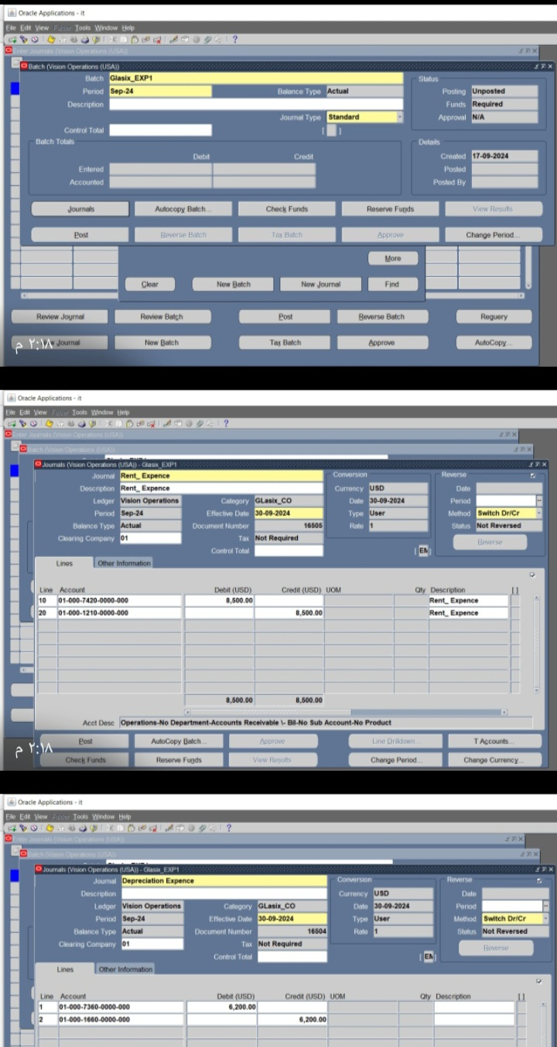
Batches
Ex: Batch for expenses
To create a batch for expenses in Oracle General Ledger (GL), you can follow these steps:
Login to Oracle General Ledger: Access Oracle E-Business Suite and navigate to the Oracle General Ledger responsibility.
Navigate to the Journals Menu : Go to General Ledger → Journals → Enter. This will take you to the Journals Entry form.
Create a New Journal Batch: In the Journals Entry form, click on the “New Batch” button .Enter the following details for the batch .Batch Name: ( Glasix_EXP1) . Description, if necessary .Accounting Period: ( Sep-24 ). Balance Type: Ensure it is set to “Actual.”
Create Journal Entries :After entering the batch details, click on the Journal button to enter the individual journal entries. In the Journals form, enter: Journal Name: ( Rent, Depreciation ,Telephone , wages& salaries ) .Description: Add a brief description if necessary. Category: ( Glasix_co ).Balance Type: Ensure it is set to “Actual.” Currency: ( USD)
Enter Journal Lines for Expenses :Click on the Lines button to enter the debit and credit lines .For each line :Enter the Account number (the GL code to which the expense is charged).Specify whether the line is a Debit or Credit .Enter the Amount for the expense .Optionally, enter a Description for each line. Continue adding lines for all expense accounts involved.

Slide 5
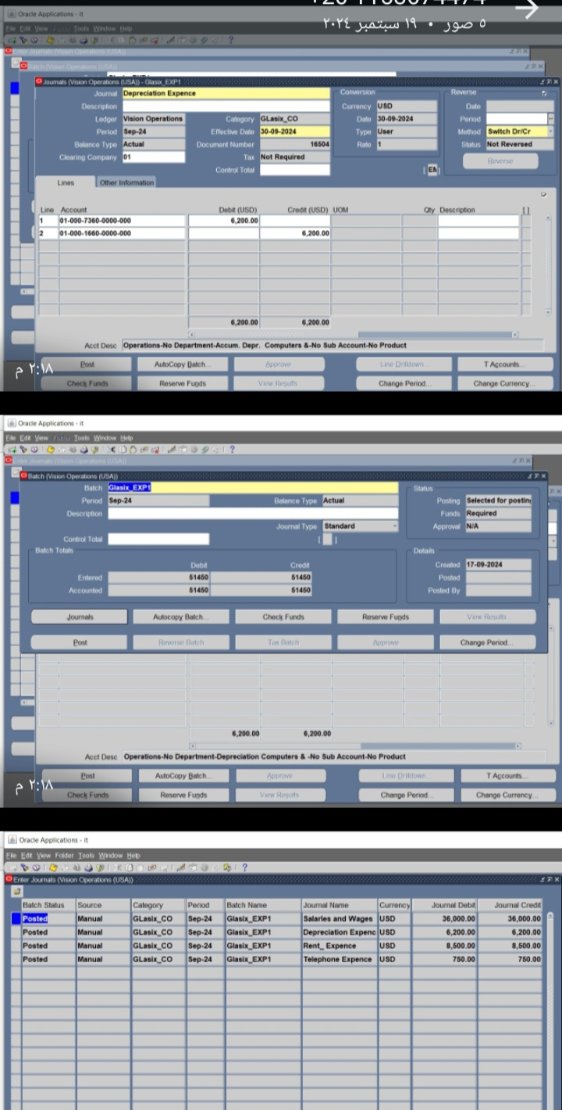
6. Complete the Journal and Validate the Batch:
After entering all journal lines, ensure that the journal is balanced (i.e., total debits = total credits).
Save your work. The system will automatically validate the journal entries for accuracy.
7. Post the Batch:
After saving and validating the journal, you can post the batch to the General Ledger.
To post, go back to the main Journals Entry form and select the batch you created.
Click on the Post button to post the batch.
8. Review and Check Posting Status:
After posting, review the status of the batch to ensure that it has been posted successfully.
You can do this by navigating to View → Requests to check the posting status.

Slide 6
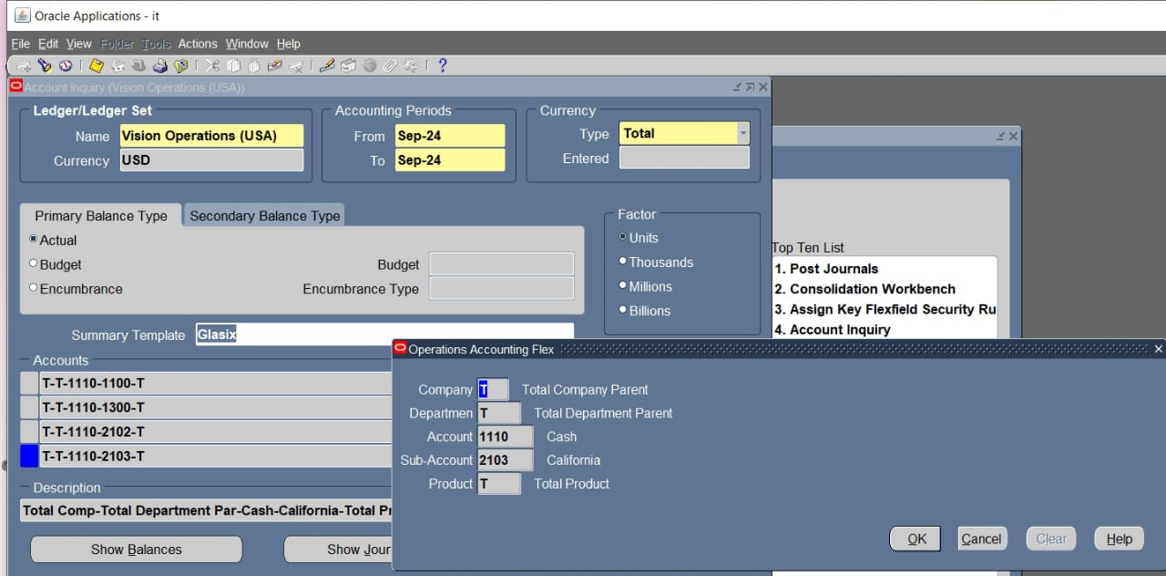
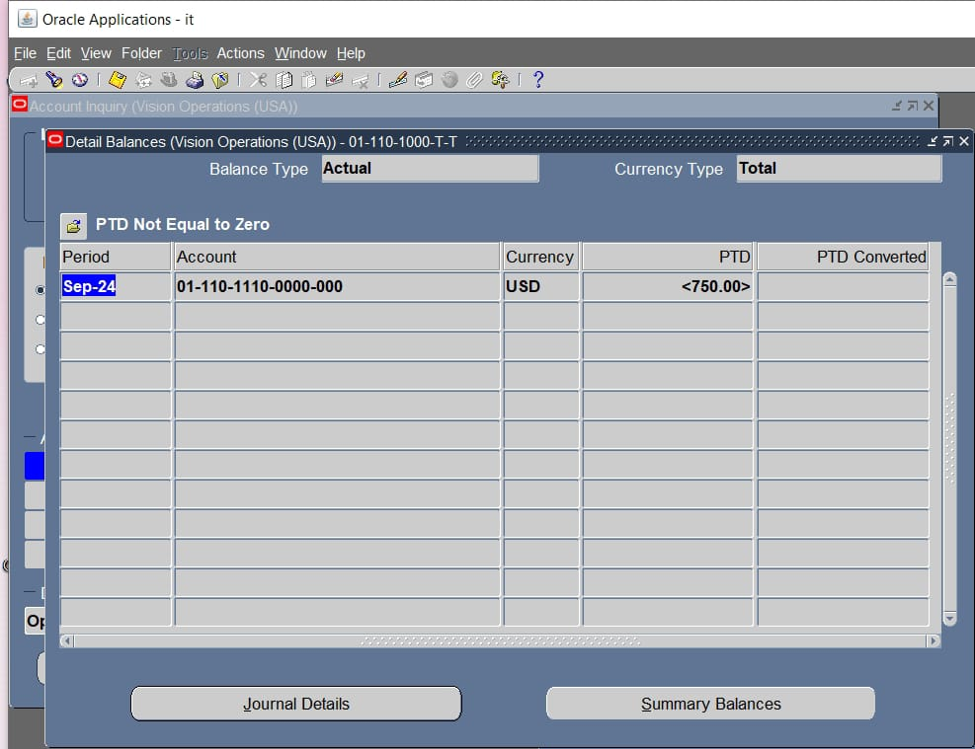
Inquiry account
To inquire about a balance or account in Oracle Digital Accounting, here are the general steps:
Log in to Oracle Application
Use your credentials to access the Oracle Financials or ERP system.
Navigate to the General Ledger
Go to the appropriate module based on the account type (e.g., General Ledger for overall balance).
Select 'Inquire' or 'Account Inquiry'
Choose the “Inquire” option under the module. This is where you can search for specific account balances or transaction details.
Enter Account Information
Input the account number, period, or other search criteria (such as customer name or transaction date).
Run the Inquiry
Click on "Submit" or "Search" to retrieve the account information.
View Results
Review the displayed balance, transaction details, or other account information.
Export or Print (Optional) If needed, you can export the results to Excel or print a summary.

Slide 7
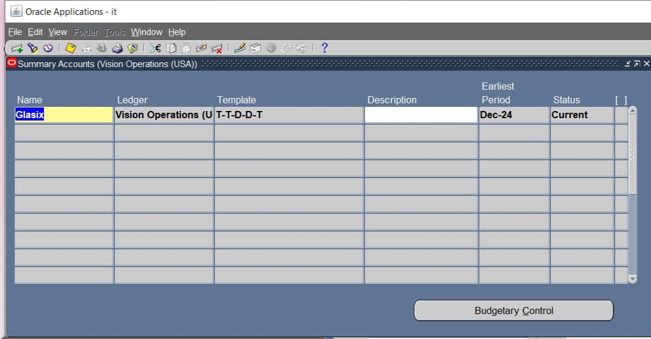
Summary account
To create Summary Accounts in Oracle General Ledger as part of the Oracle Digital Accounting Specialist course, follow these steps:
- Navigate to Summary Accounts: Go to the General Ledger responsibility > Setup > Financials > Flexfields > Key > Accounts > Summary.
- Create New Summary Template: Click on "New" to create a new summary account template.
- Define the Summary Account: Enter the Chart of Accounts structure. Specify the account segments where you want to summarize values (using wildcard characters like 'T' for Total and ‘D' for constant values).
- Save the Template: Once your account segments and summary account setup are complete, save the changes.
- Generate Summary Templates: After saving, run the "Generate Summary Template" process to create summary balances for the account.

Slide 8
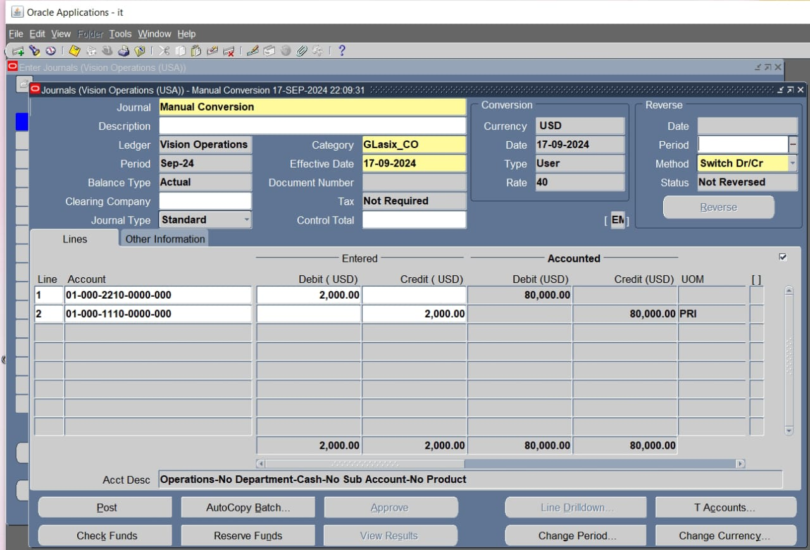
How to change rate manually in GL module using Oracle EBS
In Oracle E-Business Suite (EBS), to change the rate manually in the General Ledger (GL) module, you can follow these steps:
Navigate to Journals:
Go to General Ledger Responsibility → Journals → Enter.
Select Journal Entry:
Choose an existing journal entry or create a new journal entry by clicking New Journal.
Enter Journal Details:
Enter the journal name( conversion ) , category(Glasix_Co ) , and other required information.
Choose USD:
In the Currency field, select the currency for which you want to change the rate ( EGP).
Enter Currency Rate Manually(.8333333333)
Select the Currency Conversion Type field (D_RATE).
Now, in the Conversion Rate field, you can manually input the desired exchange rate.
Complete the Journal:
Once you've entered the necessary details and the manual exchange rate, you can complete the journal entry by saving it and posting the journal.

Slide 9
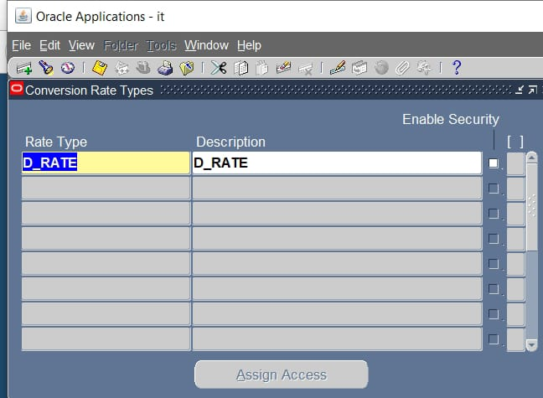
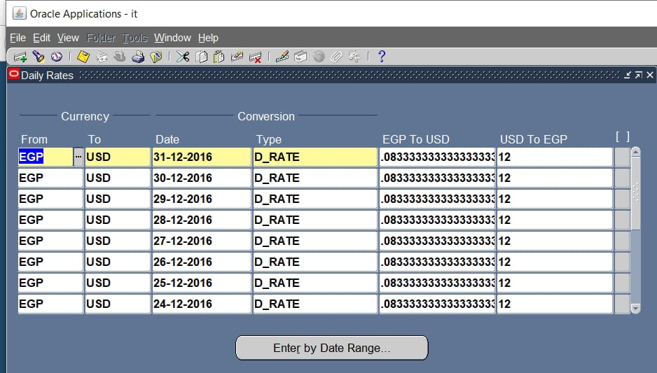
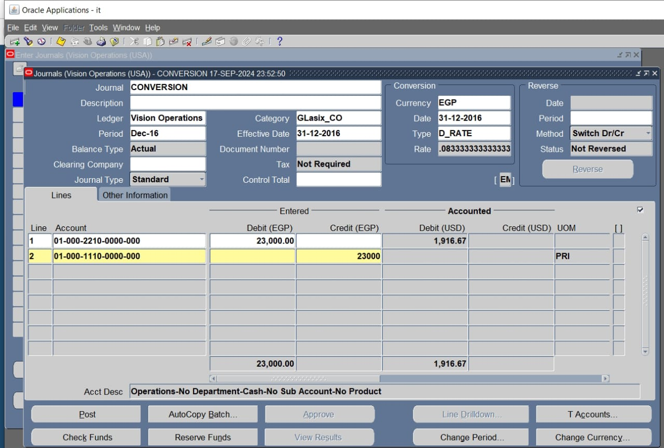
To create and maintain exchange rates in the General Ledger (GL) module of Oracle E-Business Suite (EBS), you can follow these steps:
Step 1: Define Rate Types
Navigate to: Setup → Currencies → Rate Types.
Enter Rate Type: Define a name for the rate type for (D_RATE ).
Enter the Conversion Method: This can be "Multiply" or "Divide" depending on how rates are quoted.
Save the changes.
Step 2: Define Daily Rates
Navigate to: Setup → Currencies → Rates.
Select a Rate Type: Choose the rate type (D_RATE ) from the list of values.
Select From and To Currencies: Specify the currency pair for which you are defining the exchange rate.( from EGP to USD )
Enter the Exchange Rate: Specify the conversion rate.(.08333333333333)
Enter Date: Set the effective date for the exchange rate.

Slide 10
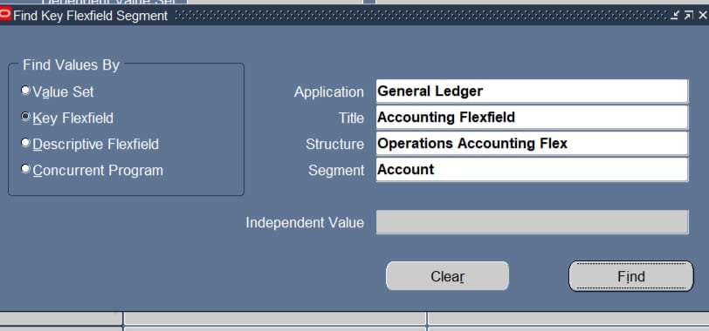
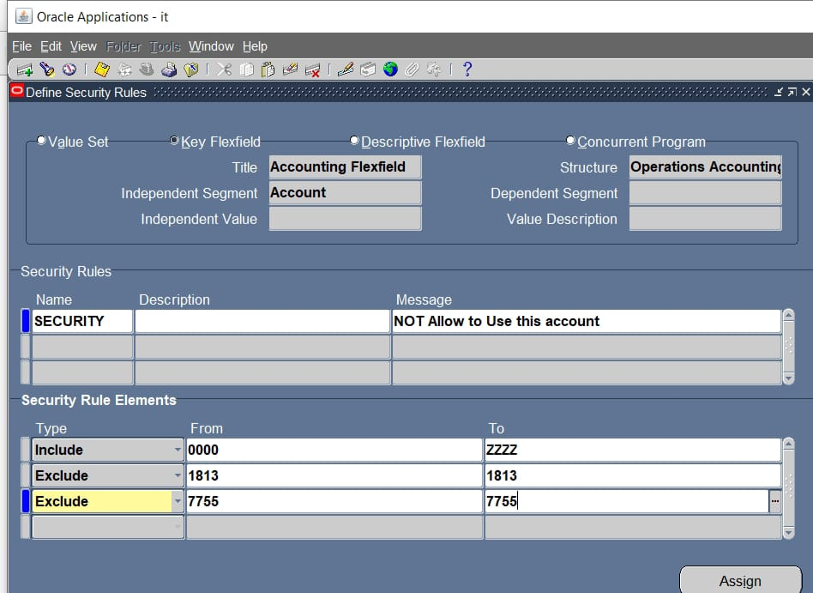
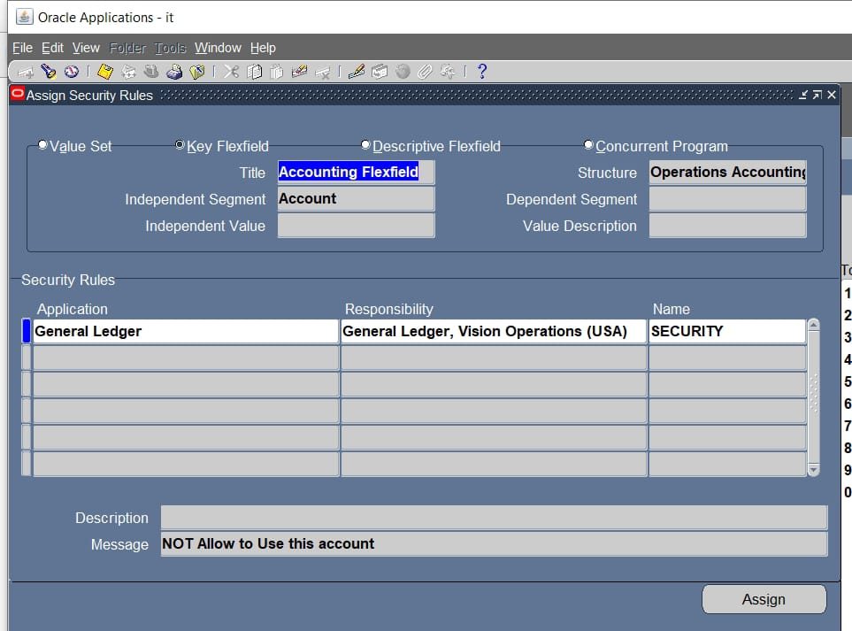
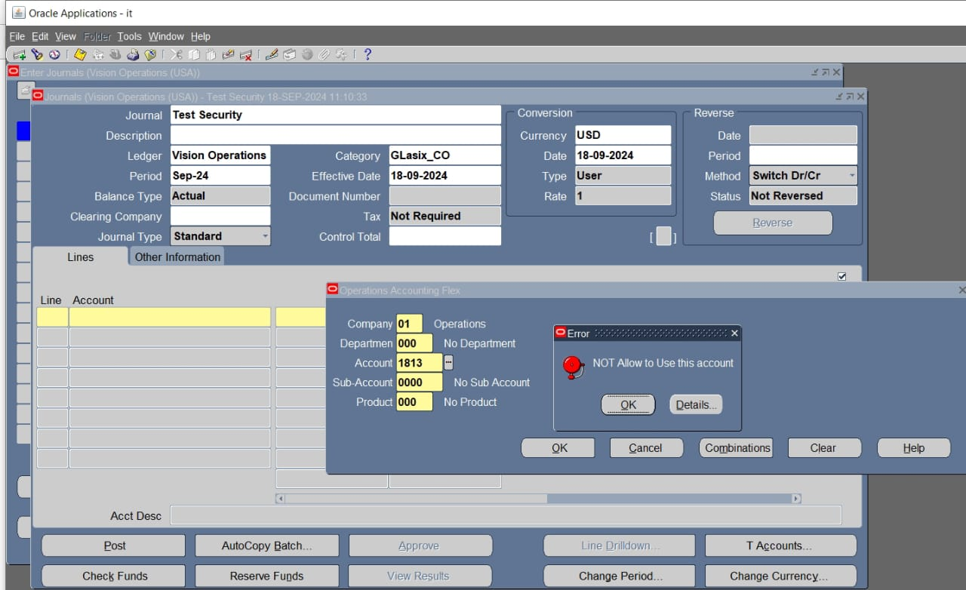
How To define a security rule in the General Ledger (GL) module
1. Navigate to Security Rules Setup
• Responsibility: General Ledger Super User (or any responsibility with access to GL setup).
• Menu Path: Setup → Financials → Flexfields → Key → Security → Define.
2. Create a New Security Rule
• Application: Choose the relevant application ( General Ledger).
• Title: Enter a title for the security rule that reflects its purpose.( Accounting flexfield)
• Structure: Choose the accounting flexfield structure for which the rule is being defined.( Operations accounting Flex )
• Segment: ( Account)
• 3. Define Security Rule Elements
• In the Security Rule Elements window, you define the segments and the allowed or restricted values.
• Click on Segment to specify the flexfield segment (e.g., Company, Department, Account) for which you want to apply the security rule.
4. **Assign Condition (Include/Exclude Values)

Slide 11
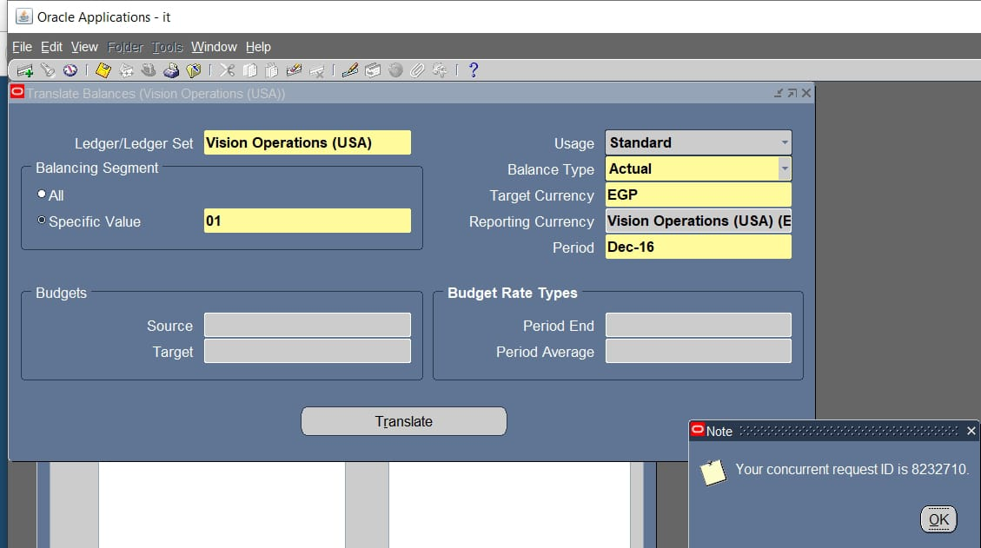
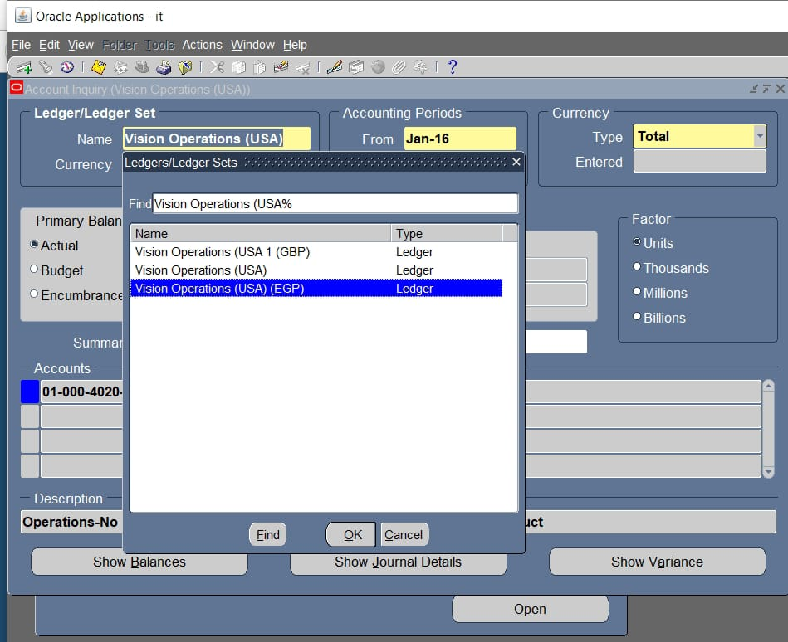
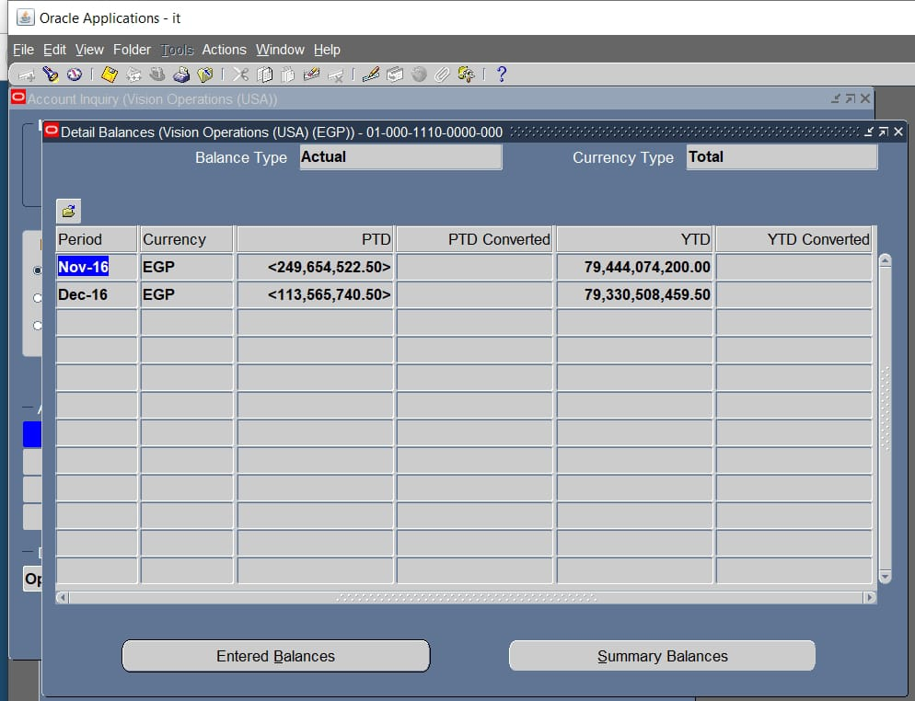
To translate a currency in the General Ledger (GL) module in Oracle E-Business Suite (EBS), follow these setup steps:
1.Define Currencies:
•Navigate to Setup > Currencies > Define.
•Define the foreign currencies you will be using.
2.Set Up Daily Rates:
•Go to Setup > Currencies > Rates > Daily.
•Define the exchange rates for each currency that needs to be translated.
3.Assign Ledger Currency:
•Go to Setup > Financials > Accounting Setup Manager > Accounting Setups.
•Select the ledger for which you want to translate the currency.
•Assign the primary ledger and select the reporting currencies, if applicable.
4.Enable Translation Feature:
•In Setup > Financials > Currencies > Translation, check that translation options are enabled for the ledger.
5.Translation Periods:
•Navigate to Journals > Currency > Translation.
•Specify the period and currency you want to translate. You can choose whether to translate balances for each period.
6.Run Currency Translation:
•\\Go to Journals > Currency > Translation.
•Select the range of accounts, and specify whether to translate using period-end rates, average rates, or historical rates.
•Choose the source and target currency, and then run the translation process.
7.Review Translated Balances:
•After the translation process is complete, review the translated balances in Inquiry > Account > Inquiry.

Slide 12
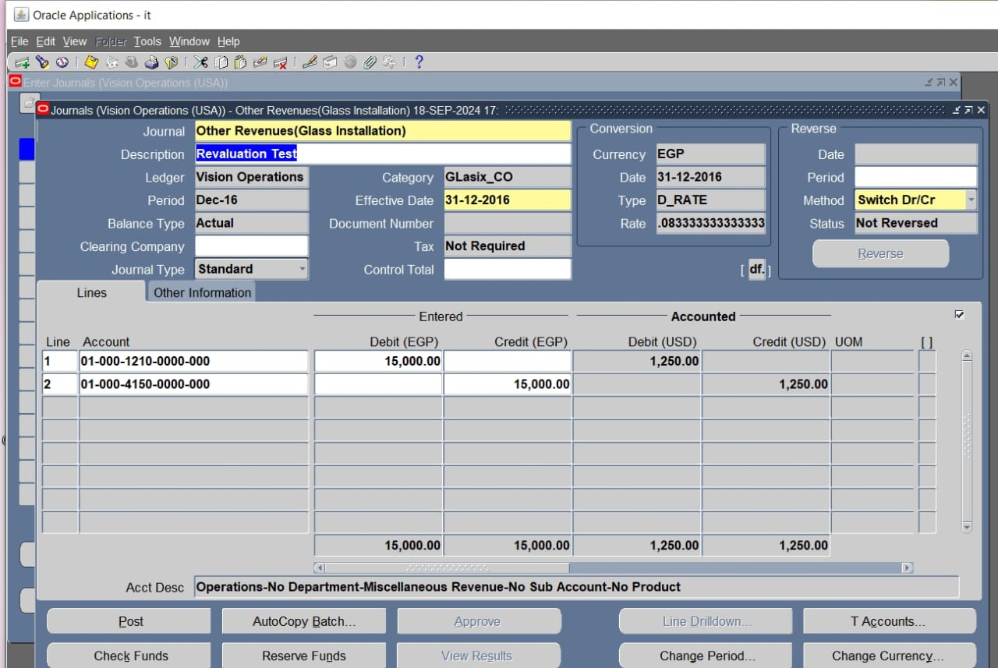
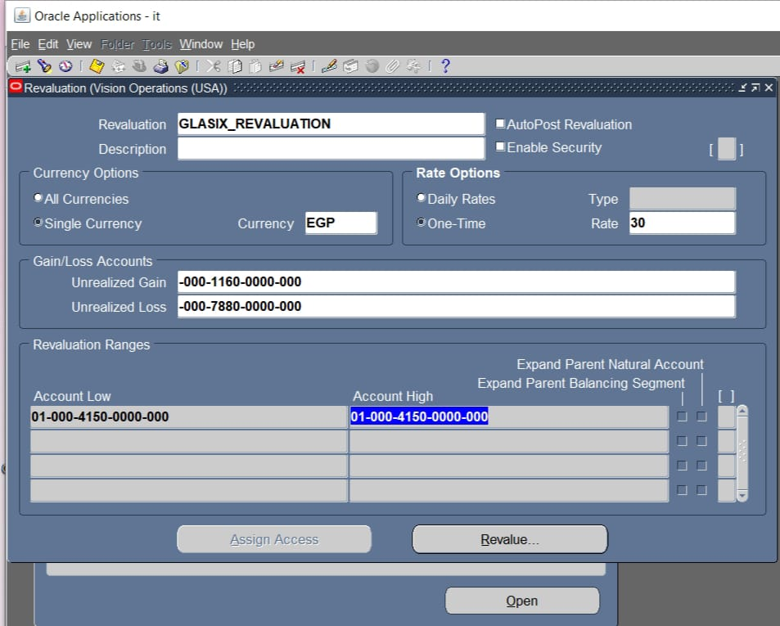
In Oracle E-Business Suite (EBS), performing a currency revaluation in the General Ledger (GL) module allows you to adjust the value of foreign currency balances due to exchange rate fluctuations
Define Revaluation Accounts (if not already done)
oNavigate to General Ledger Responsibility > Setup > Financials > Currencies > Revaluation.
oDefine the revaluation template by specifying the account range that needs to be revalued.
O Select the appropriate revaluation method: Gain/Loss or Unrealized Gain/Loss.
2. Set Up Revaluation Options
oUnder the Revaluation window, select the following:
▪Currency: Choose the currency to be revalued.
▪Revaluation Rate Type: Choose a rate type (D_rate ).
▪Rate Date: Specify the date for which the revaluation rate should apply (typically the last day of the accounting period).
▪Rate Source: Select whether the rate is manually entered or automatically derived from the system’s exchange rate setup.

Slide 13
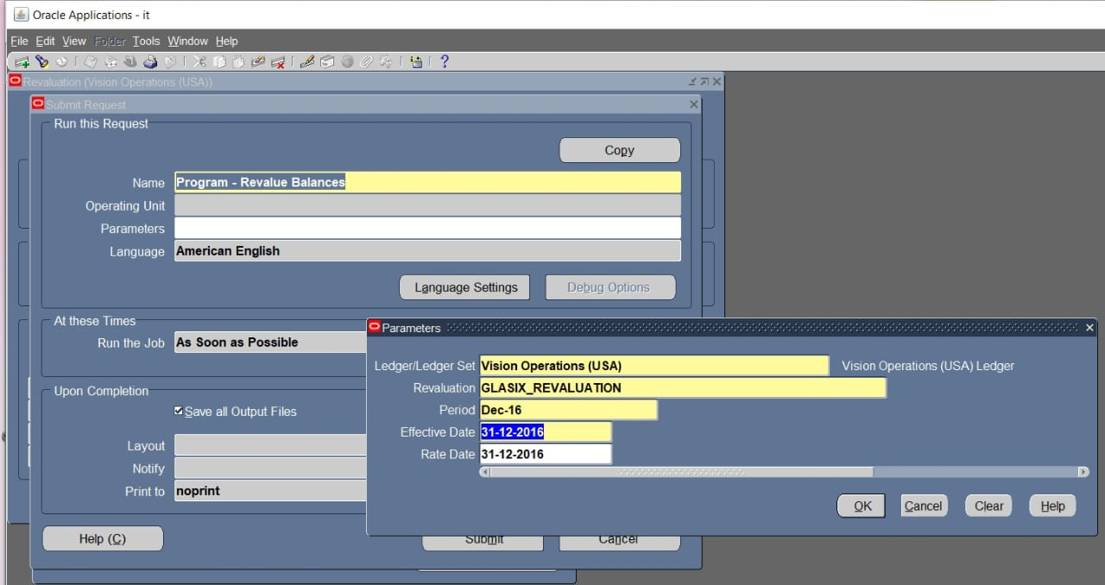
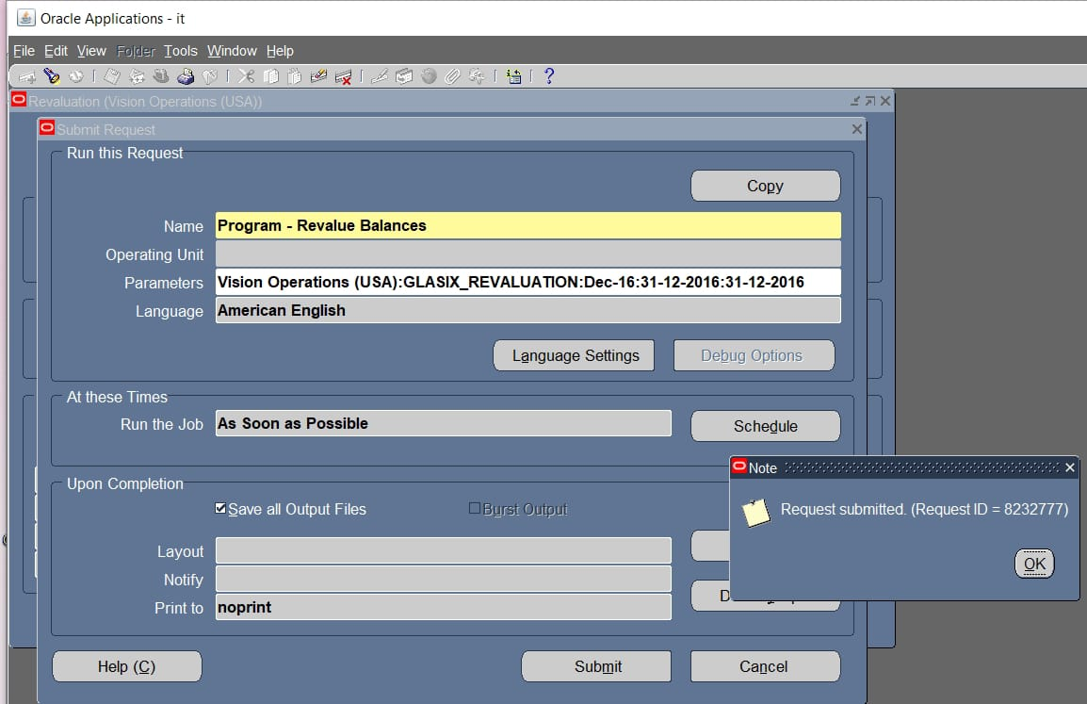
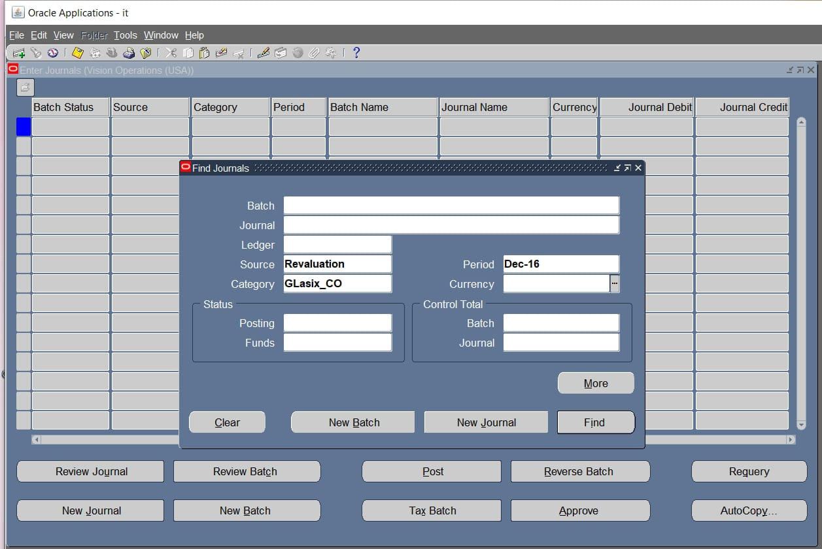
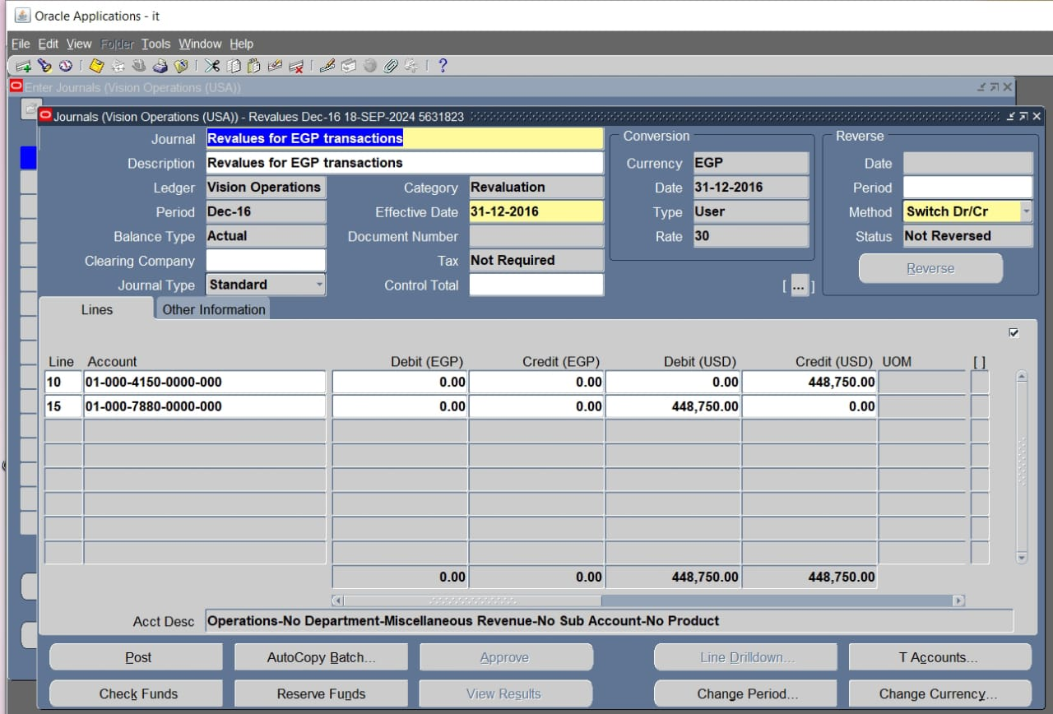
3.Run the Revaluation Process
Go to Ledger > Requests > Run.
Select Program - Revalue Balances.
oEnter the following parameters:
▪Ledger: Specify the ledger for which the revaluation is being performed.
▪Revaluation: Choose the revaluation template.
▪Accounting Period: Choose the period for which you want to revalue.
▪Effective Date: Choose the date on which the revaluation should be effective.
▪Currency: Specify the foreign currency to revalue.
Rate Type: Select the rate type used for revaluation.
4.Review the Revaluation Journal Entries
oOnce the revaluation program has completed, review the generated journal entries. The system will create unrealized gain/loss journal entries, which can be reviewed in the Journals form.
oNavigate to General Ledger > Journals > Enter.
oQuery the revaluation journal and verify the details.
5.Post the Revaluation Journals
oAfter reviewing the journals, post them to update the GL balances.
oNavigate to General Ledger > Journals > Post and post the revaluation journals.

Slide 14
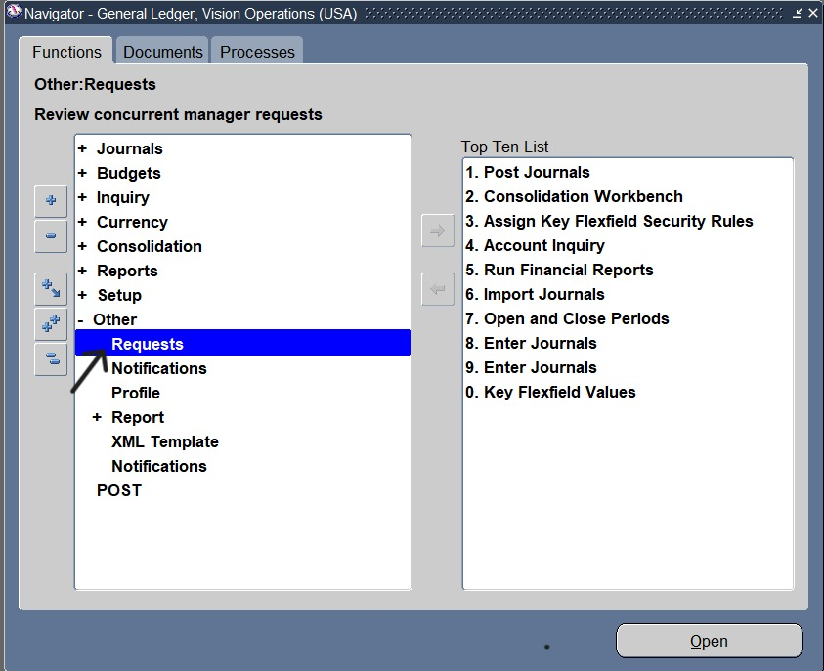
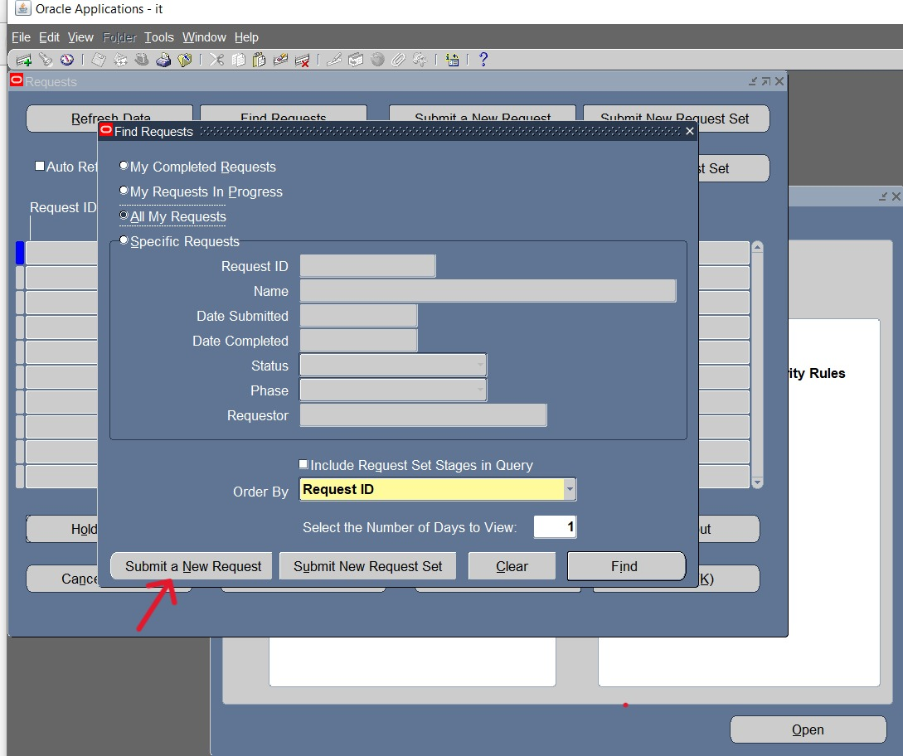
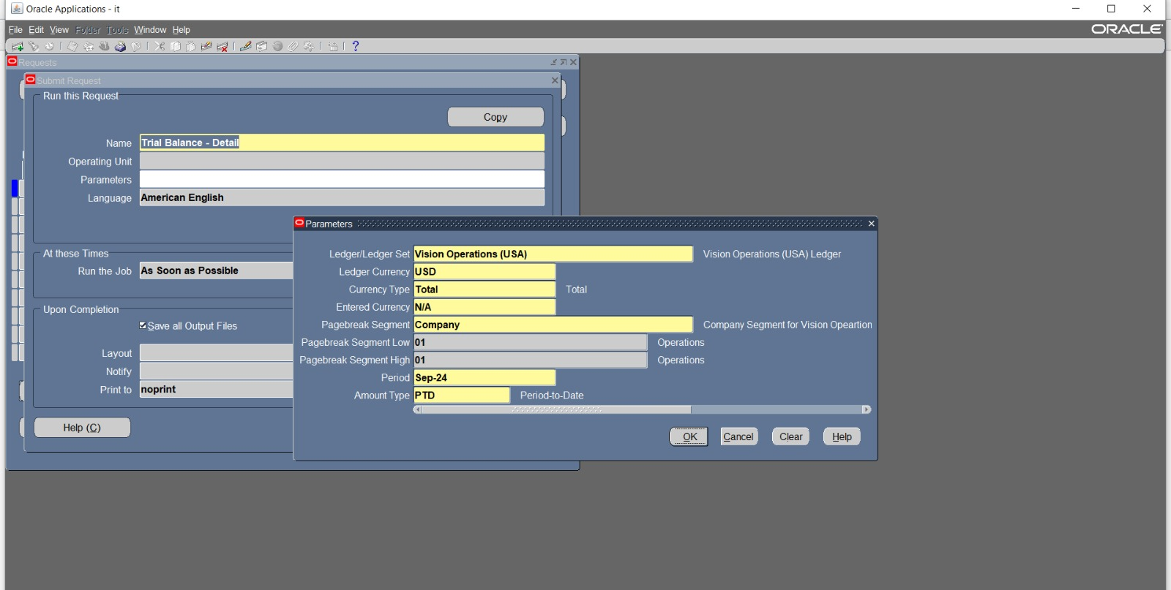
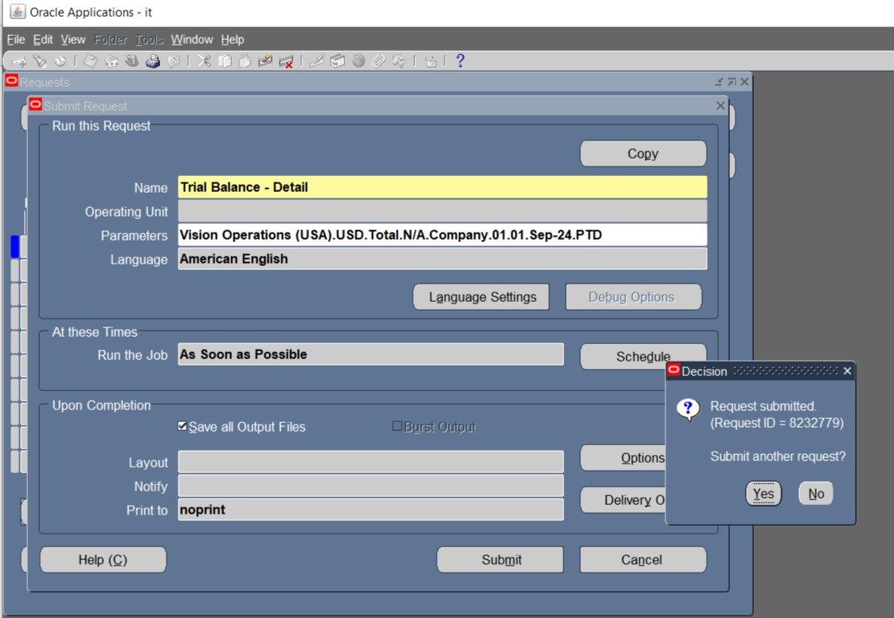
How to run a standard financial report
To run a standard financial report in the General Ledger (GL) module using Oracle E-Business Suite (EBS), follow these steps:
1.Log into Oracle EBS:
•Go to your Oracle EBS instance and log in with your credentials.
2.Navigate to the General Ledger Responsibility:
•From the main menu, select the appropriate General Ledger responsibility (e.g., "General Ledger Super User" or "General Accounting").
3.Open the Reports Submission Window:
•Go to Reports > Request > Standard.
•In the "Submit a New Request" window, select Single Request and click OK.
4.Choose the Report:
•In the "Request Name" field, choose the report you want to run, such as:
•Trial Balance (Summary or Detail)
•Income Statement
•Balance Sheet

Slide 15
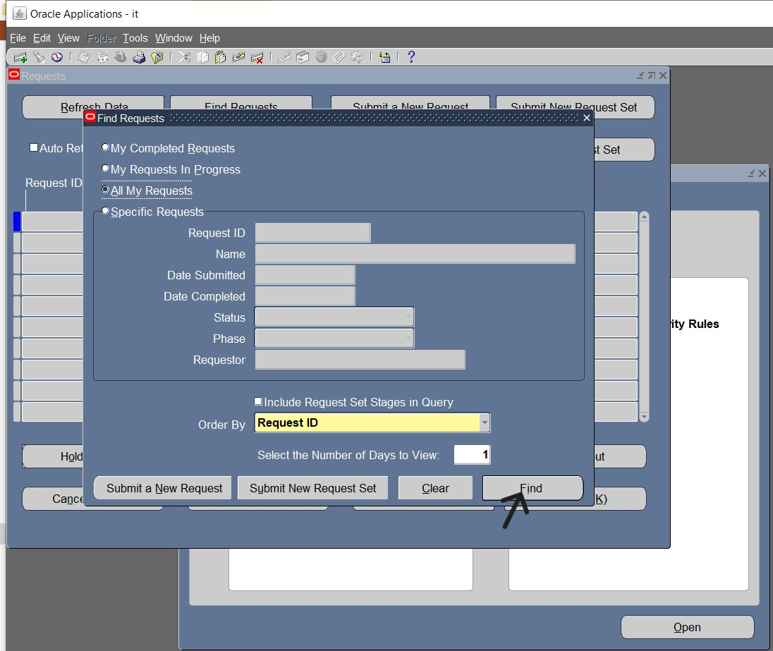
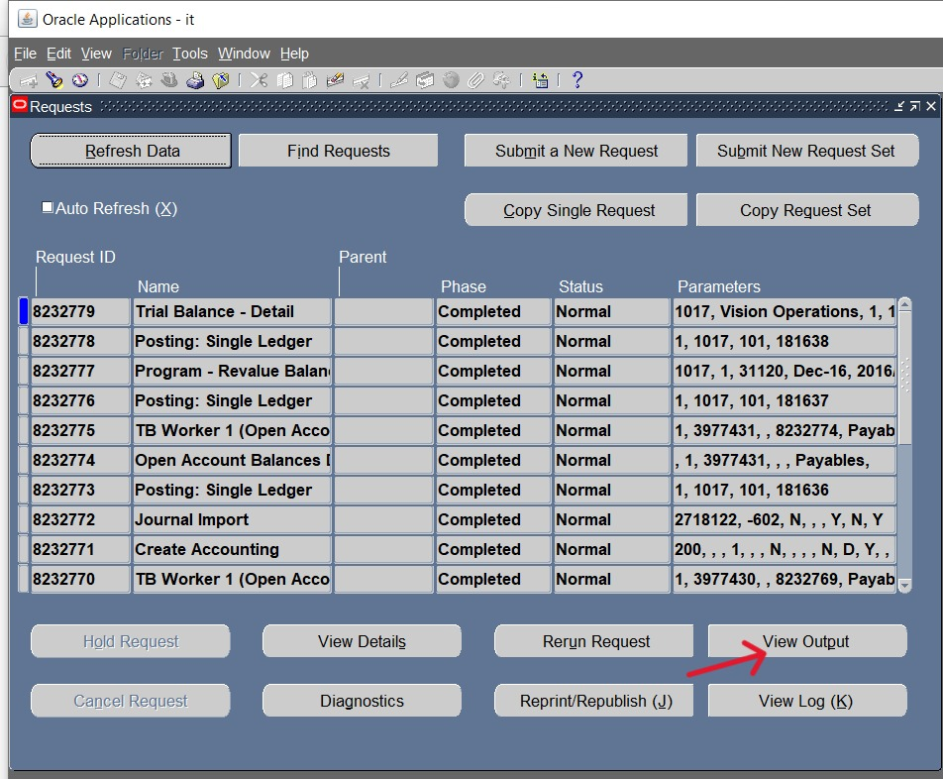
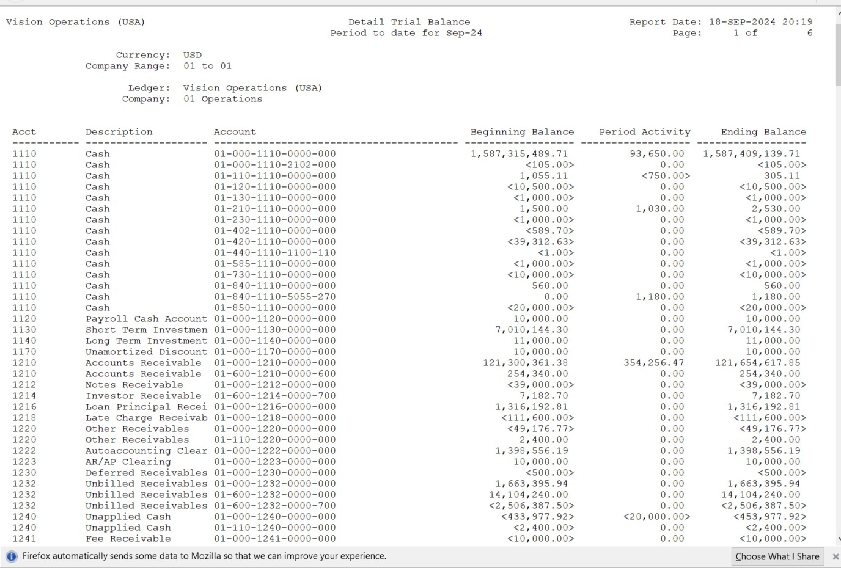
•Journal Entry Report
•Account Analysis Report
•General Ledger (various types).
5.Enter Parameters:
•After selecting the report, a parameters window will open.
•Enter the required parameters like Ledger, Currency, Period, and Account Range depending on the report type.
6.Submit the Report:
•Once you've entered all the parameters, click Submit.
•You will get a Request ID. This ID helps you track the status of the report.
7.Monitor the Request:
•To check the status of your report, navigate to View > Requests.
•Look for your Request ID and monitor the status (it should move from "Pending" to "Running" to "Completed").
8.View/Export the Report:
•Once the status is "Completed", select the request and click View Output to see the report.•

Slide 16
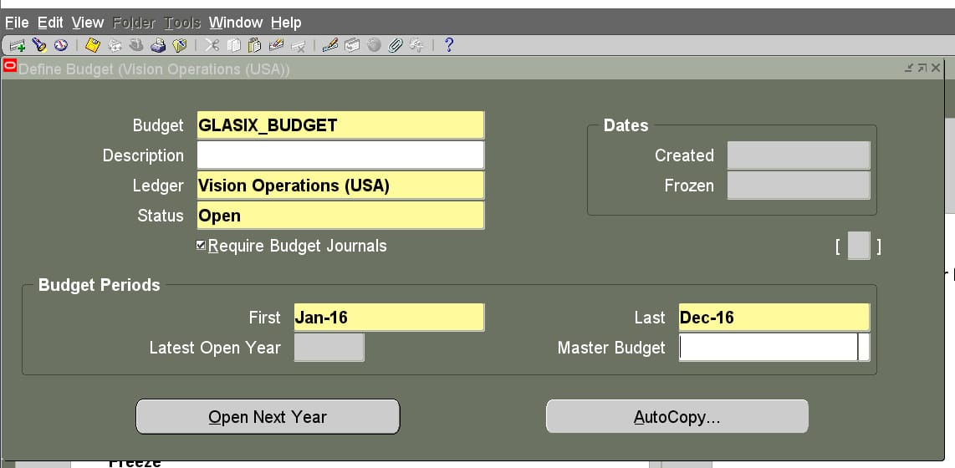
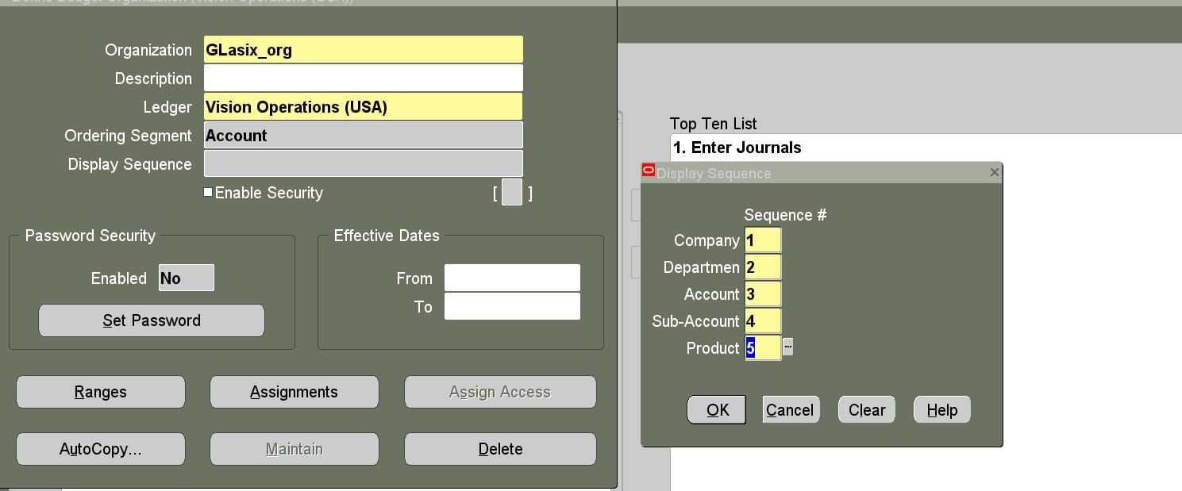
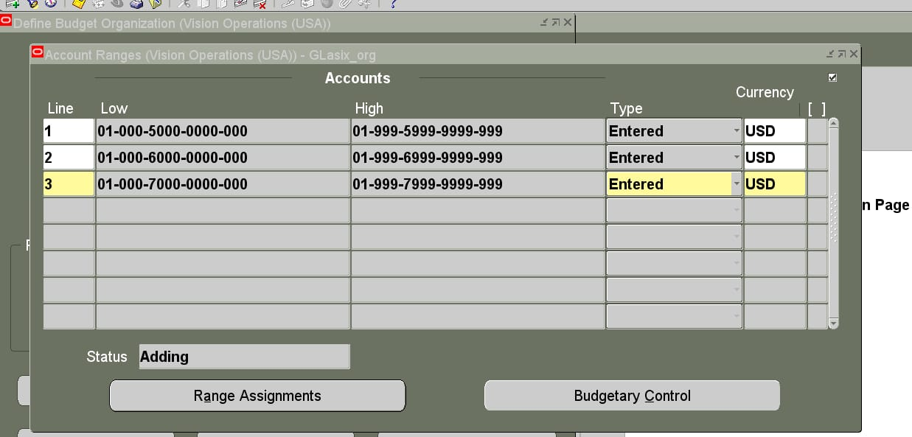
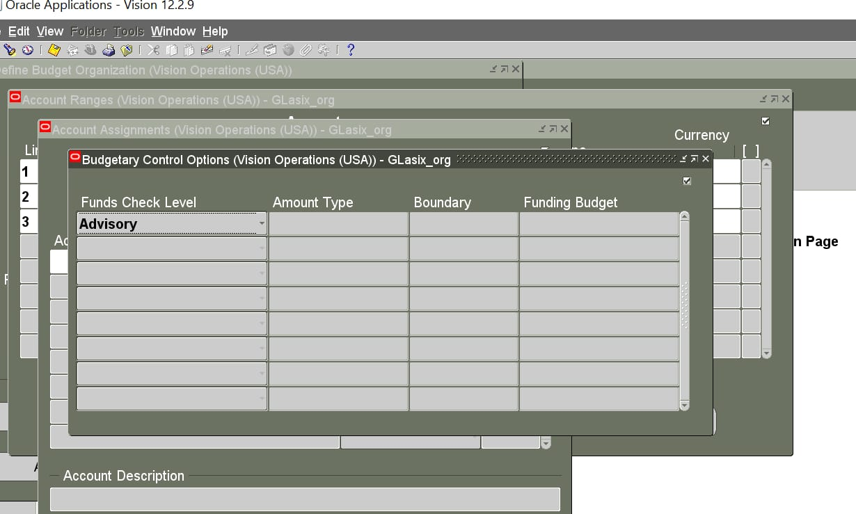
How to define budget and select ranges or specify accounts
In Oracle E-Business Suite (EBS) General Ledger (GL) module, defining a budget involves several steps. Here's a general guide on how to define a budget:
1. Navigate to Budget Definition
•Log in to Oracle EBS.
•Navigate to General Ledger responsibility.
•Select Budgets > Define.
2. Enter Budget Information
•Budget Name: Provide a unique name for the budget.
•Budget Year: Select the fiscal year for which you are defining the budget.
•Currency: Choose the currency for the budget.
•Budget Organization: Define the organization for which the budget will apply.
3. Define Budget Organization
•Navigate to Setup > Financials > Budgets > Define Budget Organization.
•Assign accounts to the budget organization by selecting ranges or specific accounts.

Slide 17
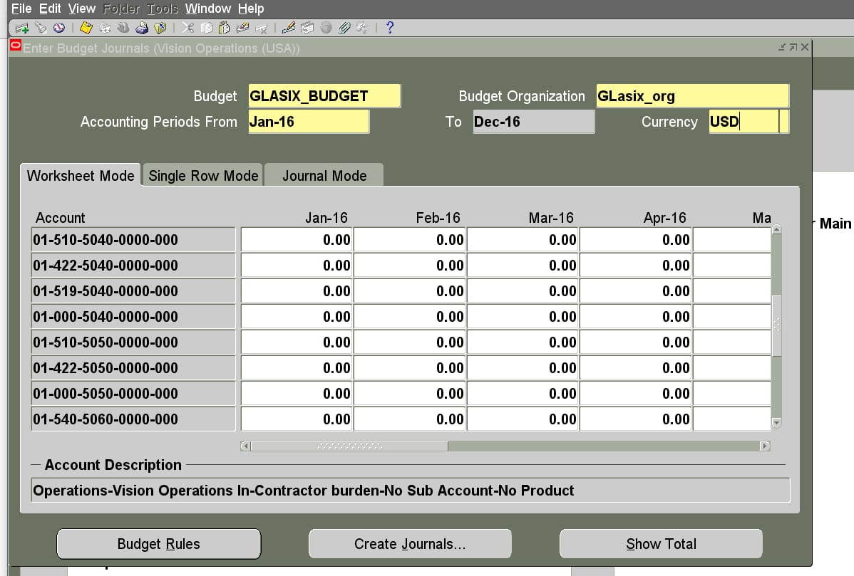
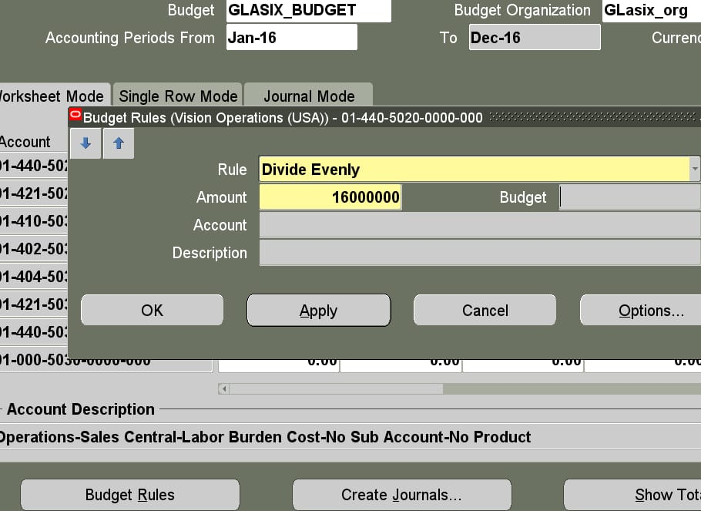
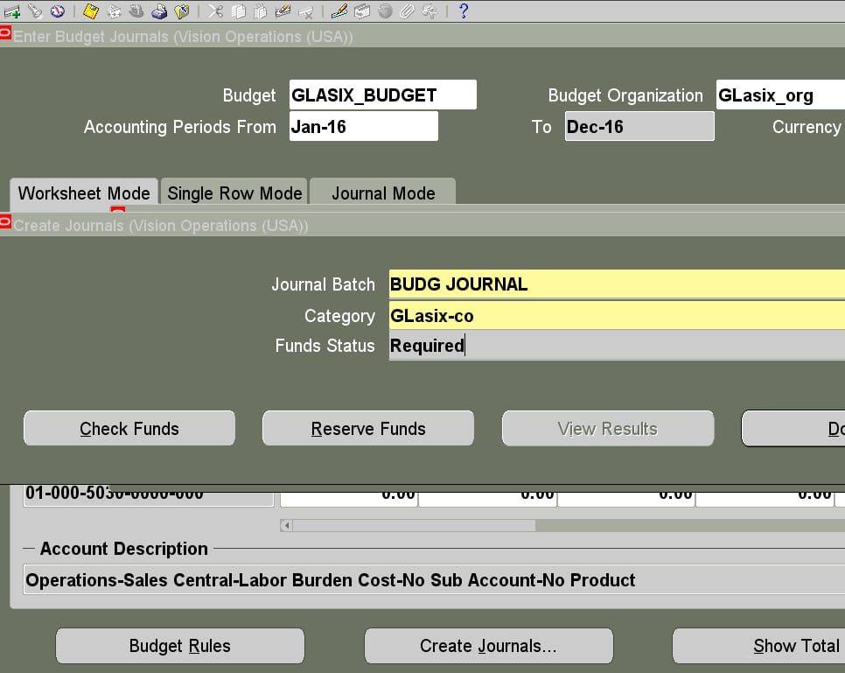
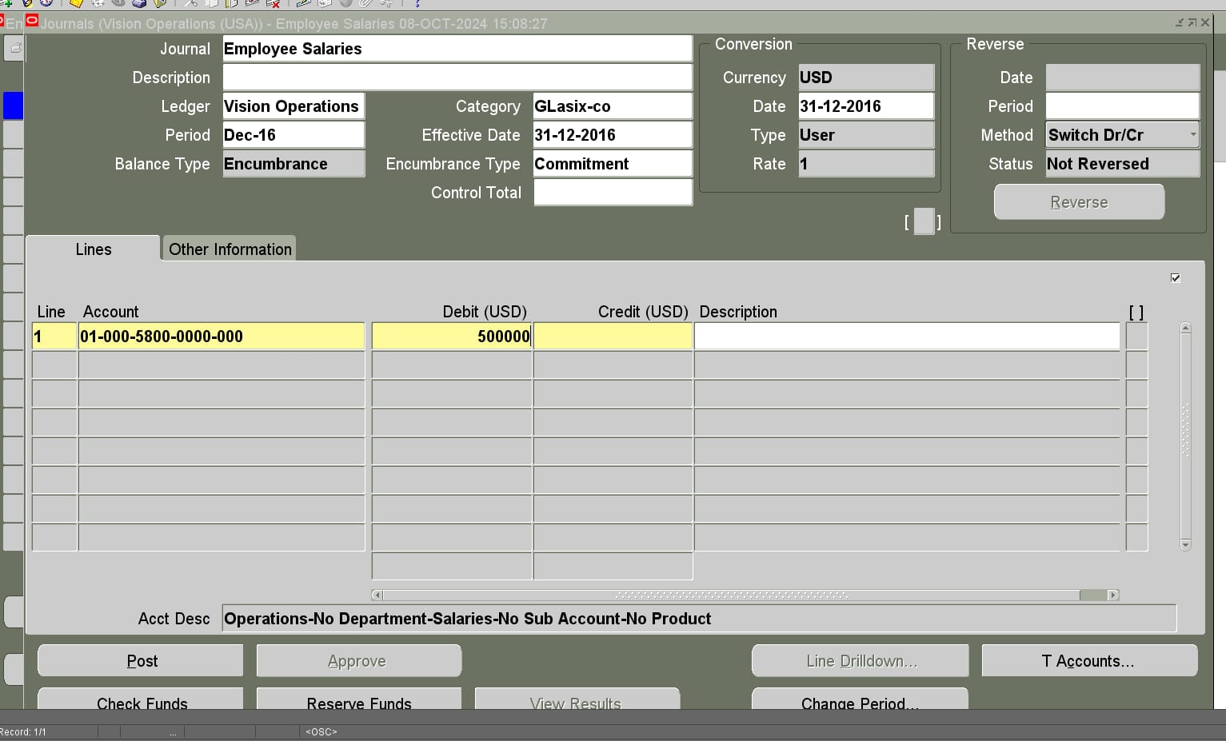
This step helps specify which accounts the budget will apply to.
4. Enter Budget Amounts
•Navigate to Budgets > Enter > Budget Amounts.
•Choose the Budget Name and Period.
•Enter budget amounts for individual accounts or account ranges for each period.
5. Open Budget Periods
•Go to Budgets > Open.
•Select the budget year and open the periods for which you want to enter budget amounts.
6. Review and Post Budget
•Once the budget amounts are entered, you can review and post the budget to the General Ledger.
•Navigate to Budgets > Review to confirm the amounts.
•If everything is correct, submit the budget for posting.
7. Budget Reporting and Inquiry
•Use Inquiry > Account to view budget balances.
•Use Reports > Request to run reports like Budget to Actuals to monitor budget performance.

Slide 18
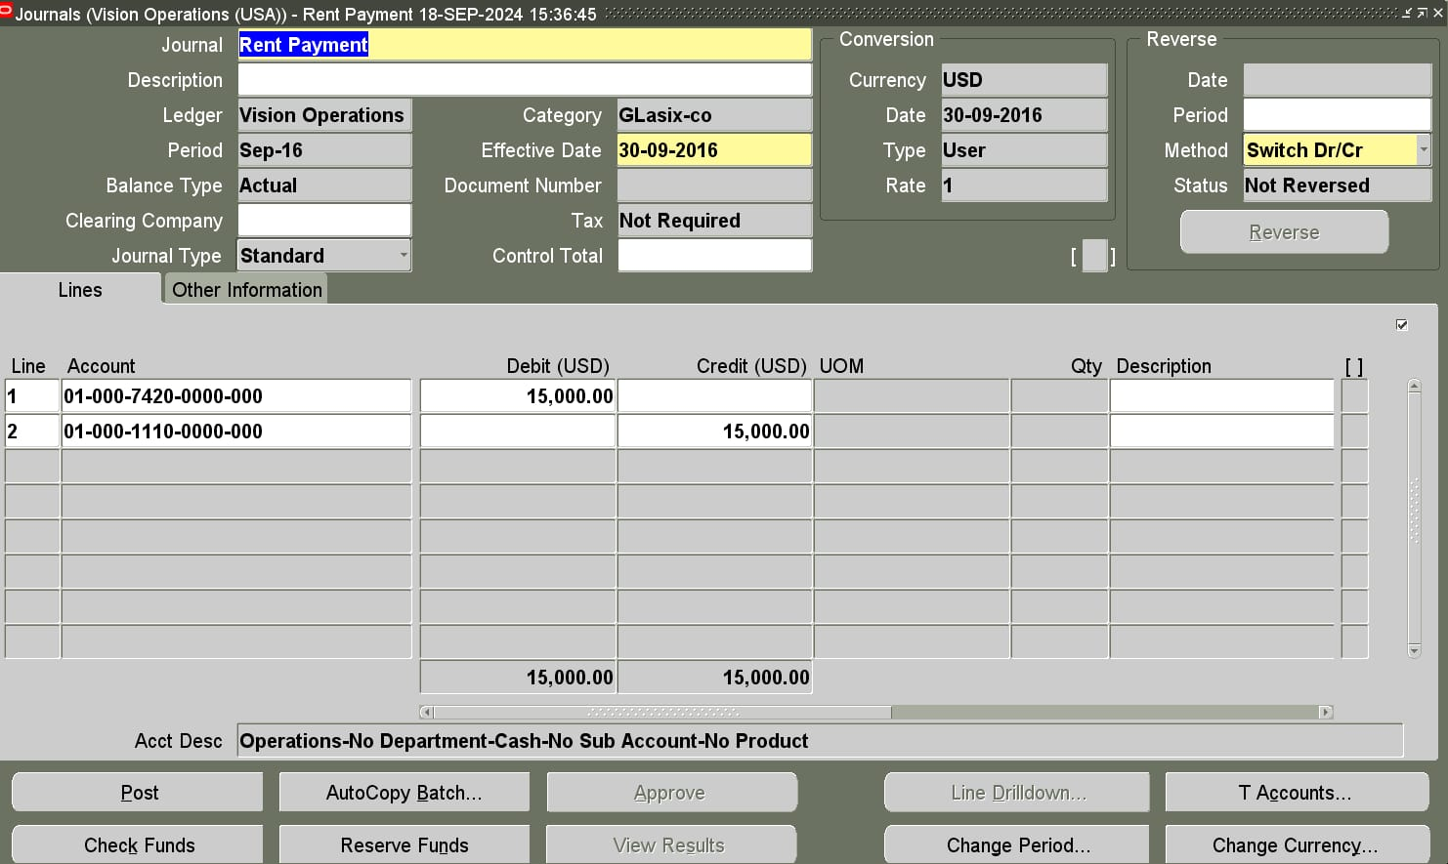
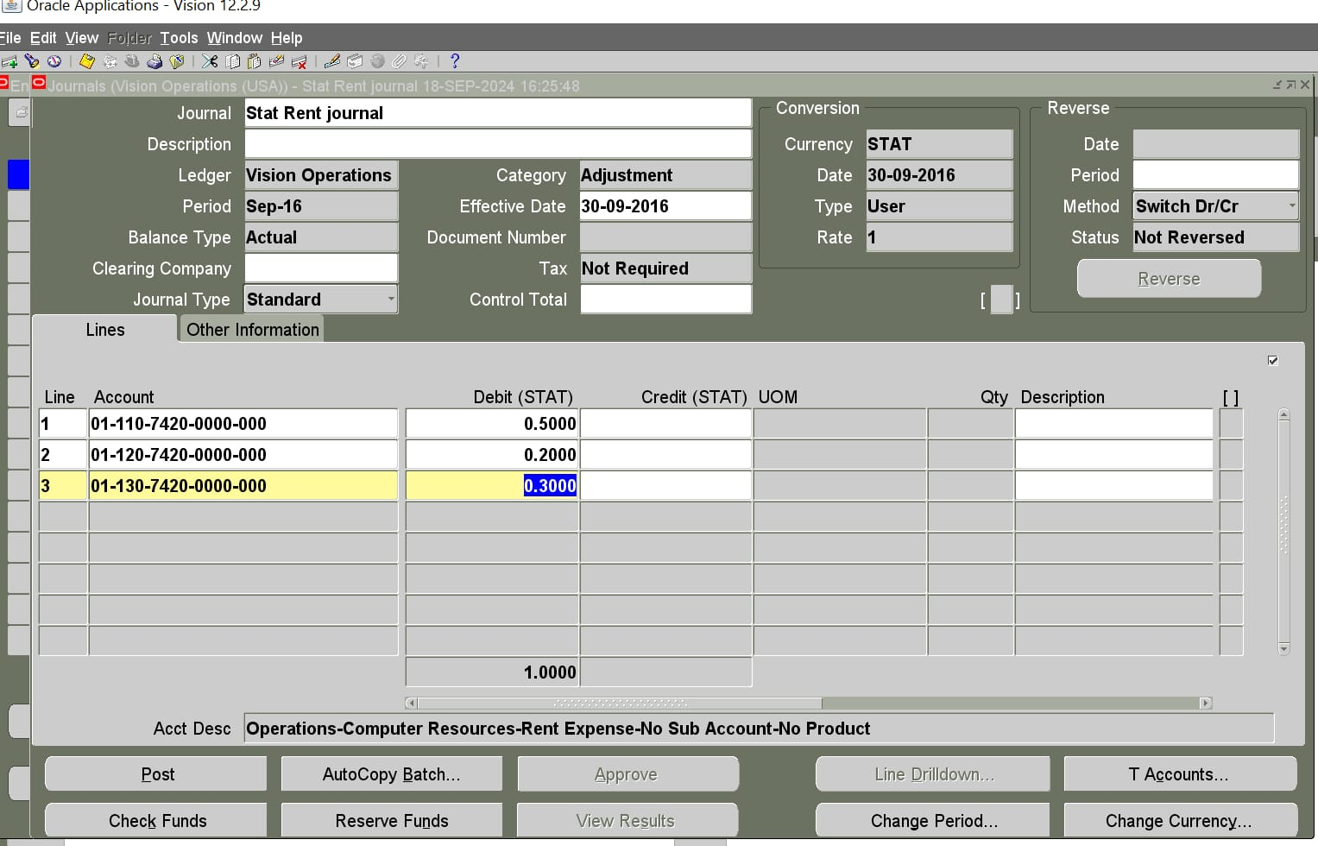
How to make mass allocations
To perform mass allocations in the General Ledger (GL) module in Oracle E-Business Suite (EBS), follow these steps
Navigate to the Mass Allocations Window:
Open the Oracle EBS application.
Navigate to General Ledger Responsibility > Journals > Define > Mass Allocations.
2. Define a Mass Allocations:
In the Mass Allocation Definition window, click New to create a new mass allocation .
Enter the Name and Description for the allocation formula.

Slide 19
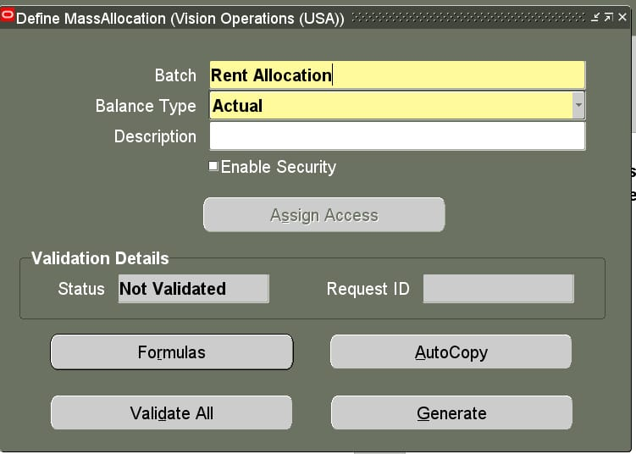
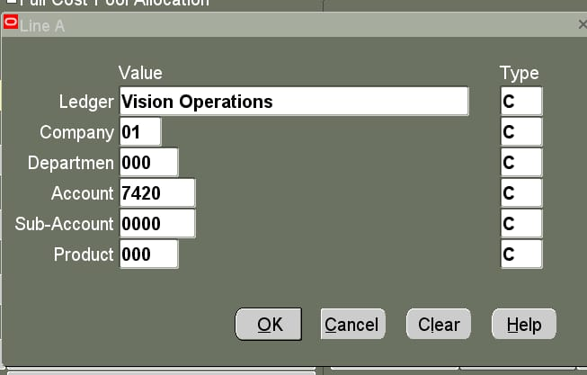
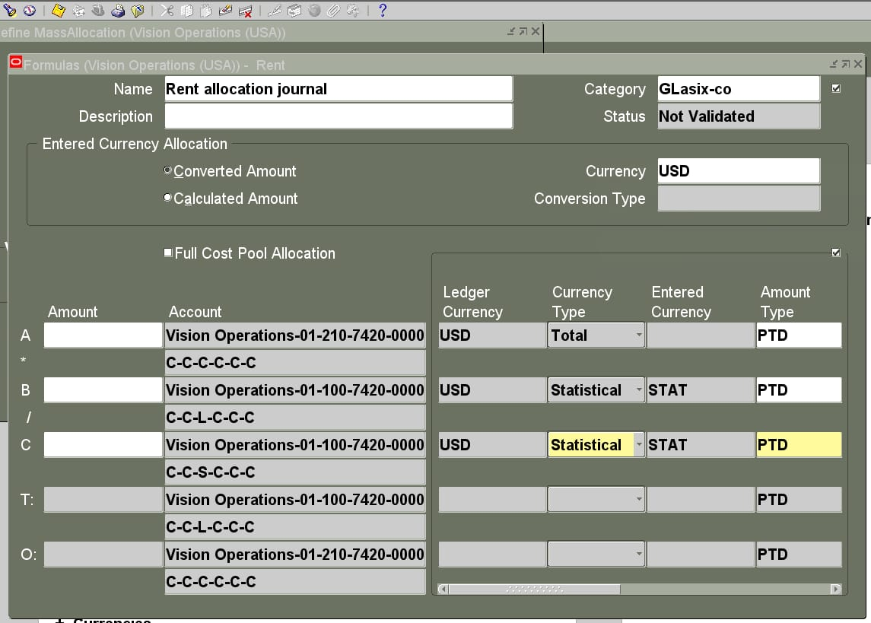
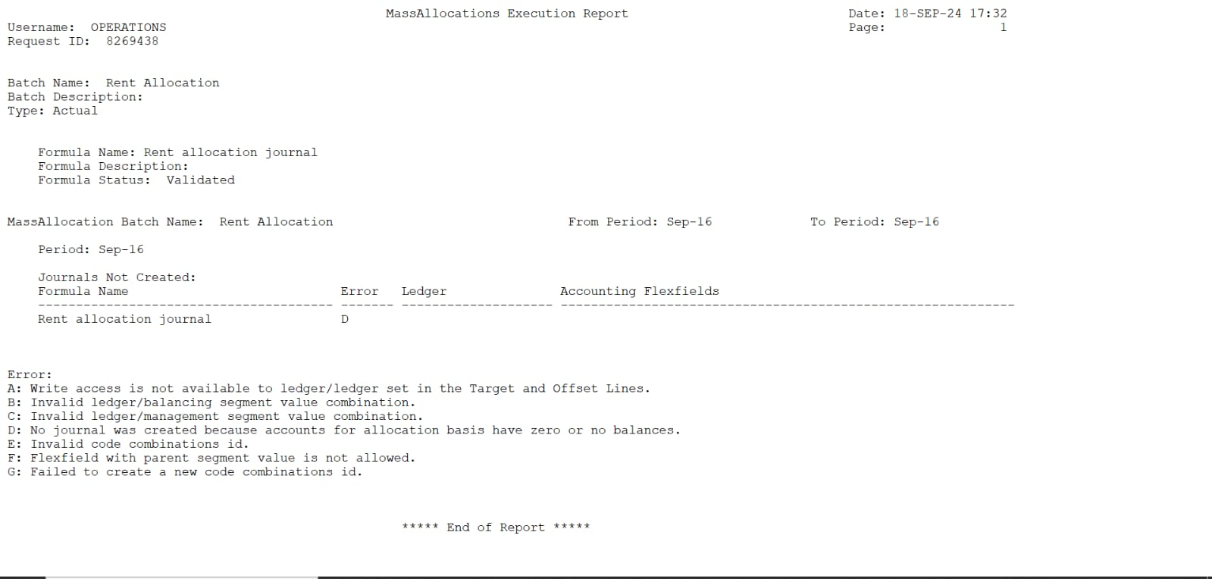
3. Define the Allocation Formula:
Source: Choose the accounts from which you want to allocate balances.
Specify the segment values (such as company, department, account) that will provide the data for the allocation.
Target: Define the accounts to which the source balances will be allocated.
Formula: Use the formula window to specify how the allocation should be calculated. This formula can include :
Operator: Multiply, divide, add, or subtract balances.
Amount :Define the percentage or amount to allocate Statistical Accounts:
You can use statistical data, such as square footage or headcount, to determine the allocation basis.
4. Review and Save the Allocation Formula:
After defining the formula, review all details to ensure accuracy.
Click Save to save the allocation.
5. Generate the Mass Allocation Journal:
To generate the journal entries based on the mass allocation formula, go to: General Ledger Responsibility > Journals > Generate > Mass Allocation.
Select the mass allocation you defined and click Generate.
Review the Journal Entries created from the mass allocation in the Journal Entry window.
6. Post the Journal Entries: After verifying the generated entries, navigate to the Post Journals form and post the journal.

Slide 20
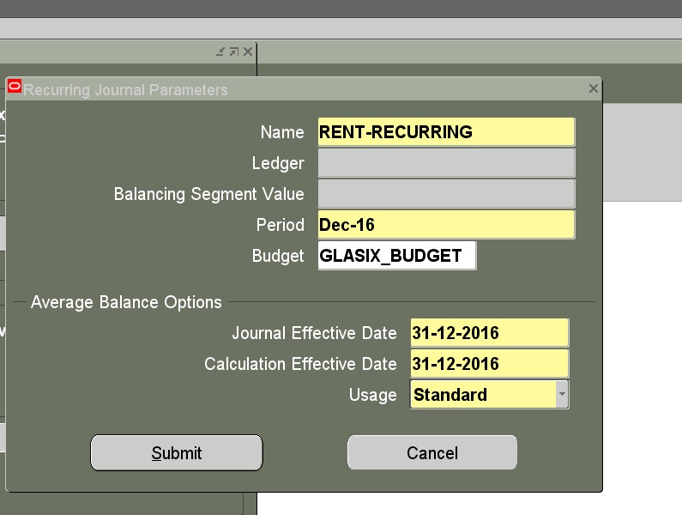
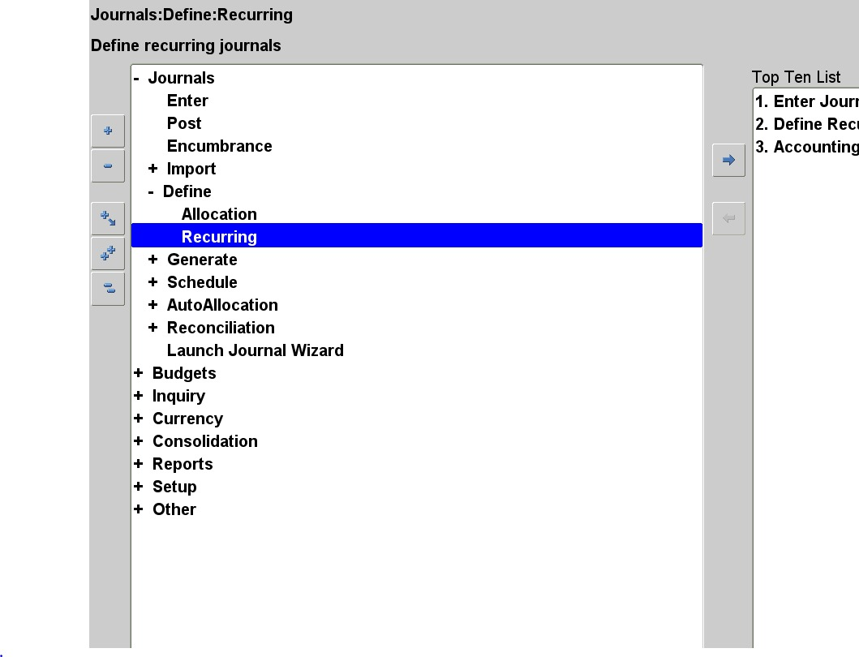
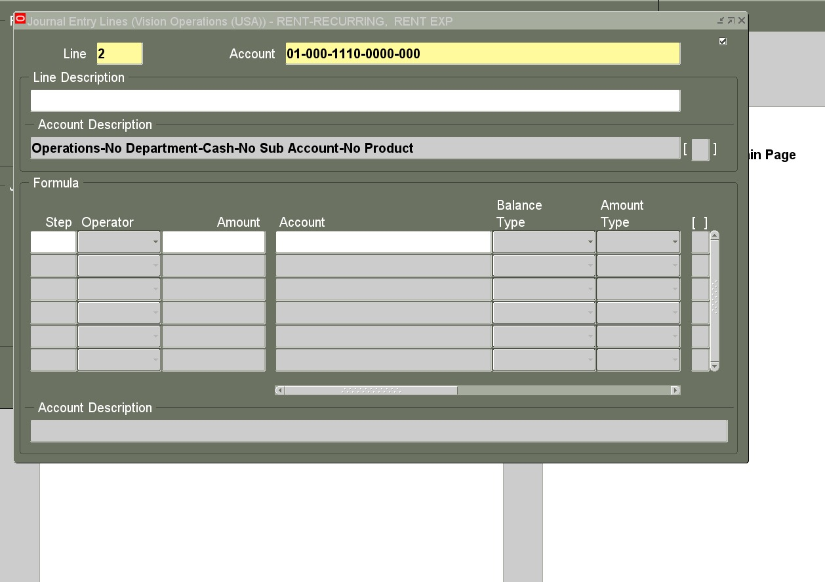
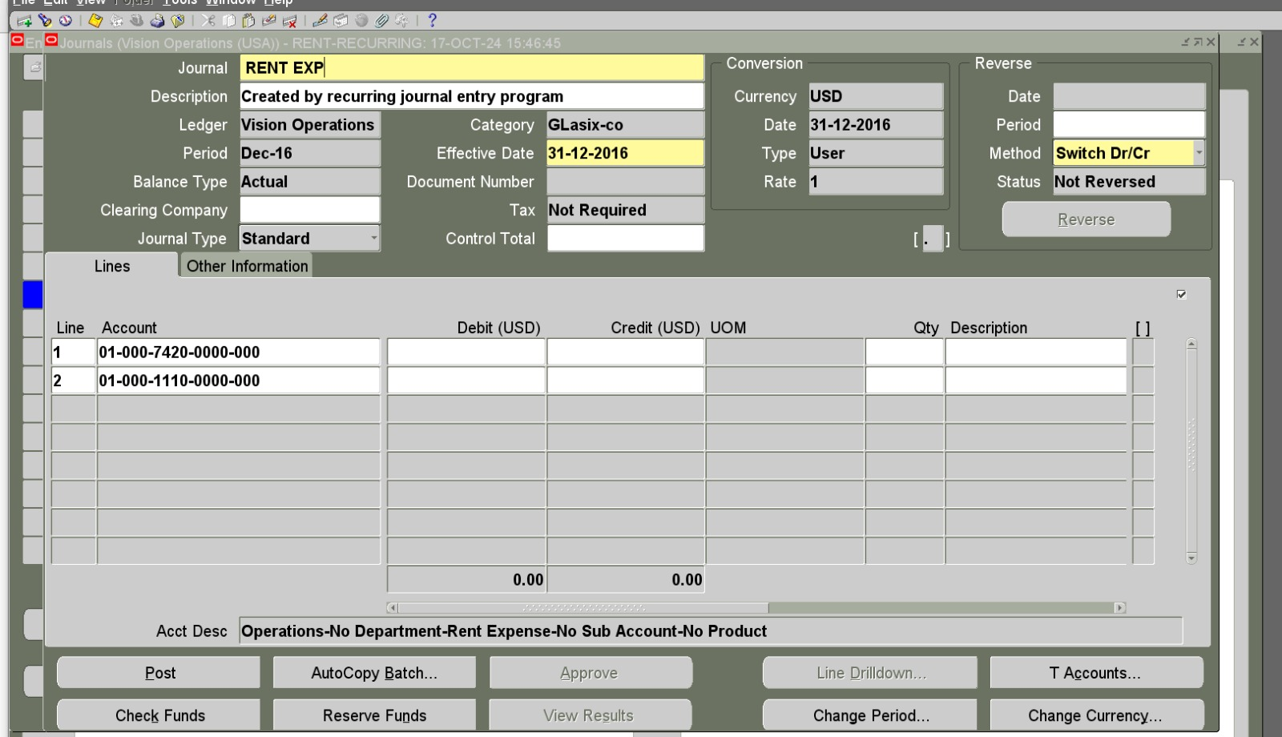
How to define recurring in Oracle digital accounting system
The term "recurring" refers to something that happens repeatedly at regular intervals. In accounting, recurring entries or transactions are those that are repeated periodically, such as monthly, quarterly, or annually.

Slide 21
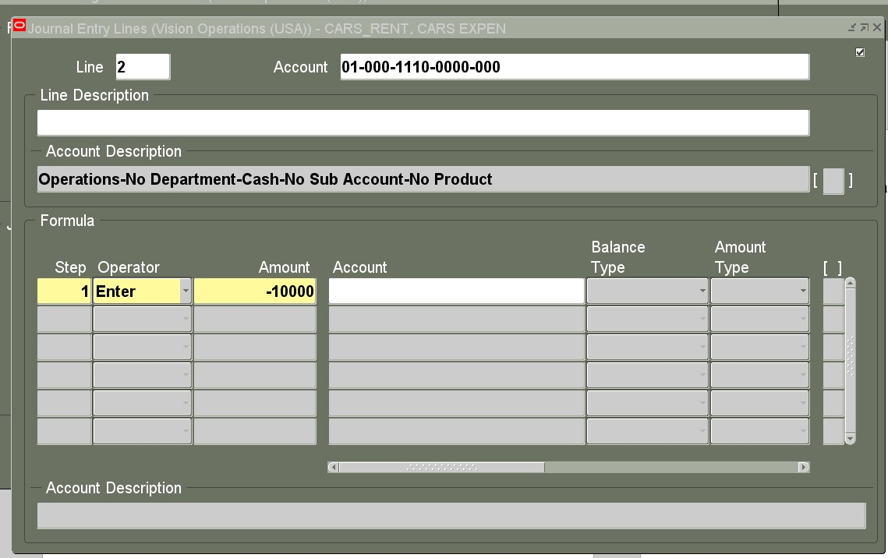
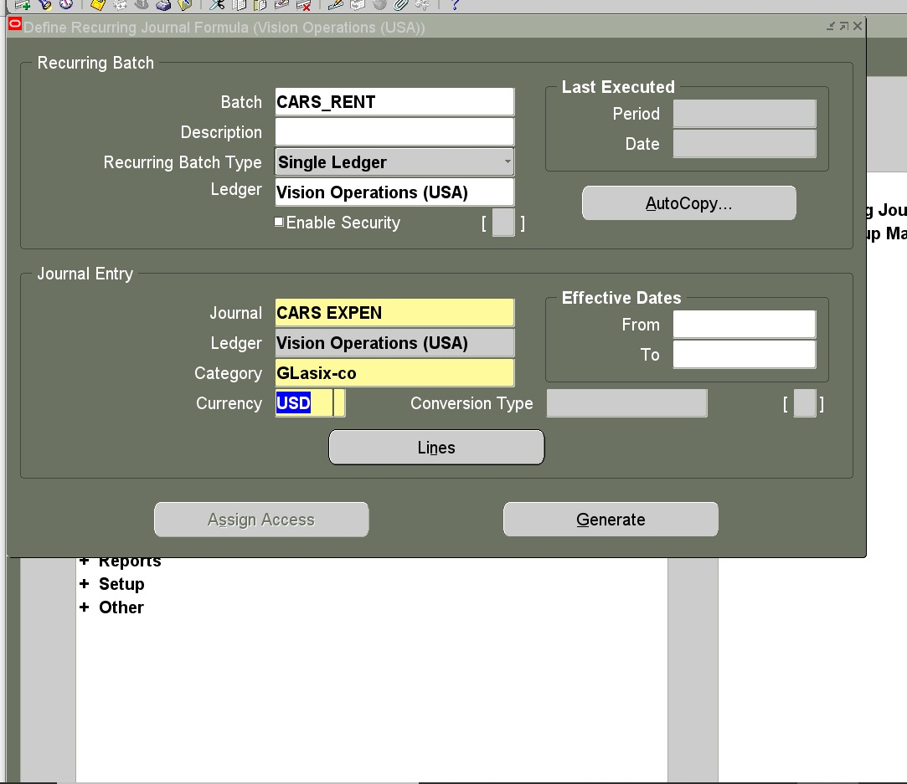
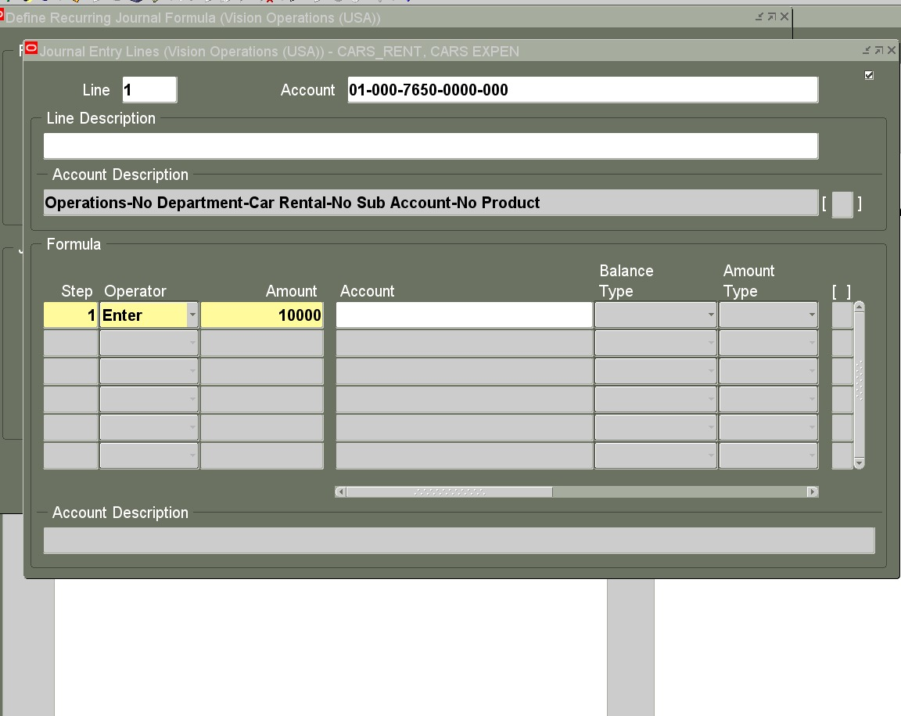
Here’s how to define and create recurring journal entries
1. Define Recurring Journals in Oracle:
Go to General Ledger from the Navigator
Under Journals, select Define recurring Journal.
2. Create a Recurring Journal Formula
In the Define Recurring Journal window, you’ll set up a formula template.
Name: Provide a meaningful name for the recurring journal (e.g., Rent, Depreciation).
Period Type: Specify the period type for the recurrence (monthly, quarterly, etc.).
Ledger: Choose the appropriate ledger for the journal entries.
3. Define the Entry Lines
Account: Enter the general ledger account for which the recurring journal will be applied.
Formula Type: Choose from three types of recurring formulas:
Standard: Fixed amounts that do not change.
Skeleton: You define the accounts but enter the amounts manually each period.
Formula: Based on a dynamic formula or calculation (e.g., percentage of
another account balance).
For Formula Type, input the appropriate amounts or formulas.

Slide 22





4. Enter Amount or Calculation
Standard Recurring Journal: Enter a fixed amount that will be posted each period.
Skeleton Recurring Journal:
Leave the amount field blank, as you'll enter it each time the journal is run.
Formula Recurring Journal:
Use arithmetic or account balances to create a dynamic calculation.
5. Define Recurrence Frequency
Specify the frequency of the recurrence (monthly, quarterly, yearly).
Define Start Date and End Date for the recurring journal to determine how long it will continue.
6. Validation and Security
Validate the recurring journal formula to ensure that the accounts and amounts are properly set up.
Set up appropriate security or approval workflows to control who can create, modify, or approve recurring entries.

Slide 23




7. Submit and Schedule Recurring Journals
Once defined, you can either manually run the recurring journal entry or schedule it to run automatically.
To schedule, use Submit Journals and specify the frequency (daily, weekly, etc.) for the recurring transaction.
8. Post the Recurring Journal
After the recurring journal is generated, review it in the Review Journal Entries section.
Post the journal to record it into the ledger

Slide 24

How to make reservation for funds
In Oracle E-Business Suite (EBS), to make a reservation of funds in the General Ledger (GL) module, you typically perform the following steps as part of budgetary control. The reservation of funds involves verifying that funds are available and then committing them to an expense or transaction. Here’s an overview of the process:
1.Enable Budgetary Control:
•Ensure that your Oracle GL has budgetary control enabled. This is done in the budget setup, where you define whether funds should be reserved at the commitment or obligation level.
2.Define Budgets:
•Go to General Ledger → Budgets → Define.
•Define the budget by entering the ledger, currency, and period information.
•Upload or enter your budget amounts to ensure that you have allocated funds for the appropriate accounts.
3.Enter Budget Journals:
•Go to General Ledger → Journals → Enter.
•Create budget journals that allocate the funds to specific accounts.
•Post the budget journal after entering it.
4.Create Encumbrance Journals (Optional):

Slide 25
If you are using encumbrance accounting (common in government or public sector organizations), you can create encumbrance journals to reserve funds.
•Go to General Ledger → Journals → Enter and create a journal with encumbrance as the journal type.
•Post the journal to reserve the funds.
5.Transaction Level Fund Reservation:
•When entering a transaction in sub-ledger modules (such as Payables or Purchasing), Oracle EBS will check whether funds are available based on the budget defined in GL.
•Once the transaction is approved, funds will be reserved automatically if the budgetary control options are enabled.
•For example, when creating a purchase order, the system checks if sufficient funds are available for the accounting combination specified.
6.Run Funds Check:
•In the sub-ledger modules (like Purchasing or Payables), Oracle EBS can run a "funds check" to ensure that funds are available before committing to the transaction.
•This step ensures that the amount you're planning to spend does not exceed the budget.

Slide 26

7.Approve and Reserve Funds:
•Once the funds check is passed and the transaction is approved, the funds are reserved in GL, reducing the available budget for that specific account.
Summary of Navigation for Fund Reservation:
•Setup Budget: General Ledger → Budgets → Define.
•Post Budget Journal: General Ledger → Journals → Enter.
•Reserve Funds via Encumbrances (if applicable): General Ledger → Journals → Enter → Select Encumbrance Type.
•Perform Funds Check (in sub-ledger modules): Ensure that the transaction type in sub-ledgers such as Purchasing or Payables reserves funds based on your budget setup.

Slide 27


Defining rows and columns for financial reports in Oracle ERP
1. Define Rows
Rows in financial reports typically represent accounts or data elements such as revenues, expenses, assets, liabilities, etc.
Steps to Define Rows:
Navigate to the Reporting Tool: Go to Reports and Analytics > Financial Reporting Center
Choose or Create a New Report: Select a report template or create a new financial report.

Slide 28


Add Accounts to Rows
In the report layout, define the rows by selecting the specific General Ledger accounts or account groupings you want to display.
For example, for an Income Statement, you might have rows for:
Revenues
Cost of Goods Sold (COGS)
Gross Profit
Operating Expenses
Net Income
You can include roll-ups of accounts (e.g., total operating expenses, total revenues).

Slide 29


Dynamic Rows
For more flexibility, use dynamic row definitions that automatically adjust based on account combinations or filters (e.g., all expense accounts for a particular department).
You can filter rows by segments such as cost center, department, or product line.
Row Formatting
Subtotals: Define subtotals for groups of rows (e.g., total operating expenses).
Filters: Apply filters to only display certain accounts (e.g., filter by department or business unit).
Formulas: You can create custom rows using formulas (e.g., a row for Gross Profit = Revenues â€“ COGS).

Slide 30


2. Define Columns (Periods, Currencies, or Variances)
Columns typically represent time periods, variances, or other financial elements such as currencies.
Steps to Define Columns:
Select Time Periods:
Columns usually represent time periods like monthly, quarterly, year-to-date, or comparison periods (e.g., current year vs. prior year).
Choose from available period options in the report template (e.g., current month, last year, or fiscal year).

Slide 31


Add Currency/Unit Conversions:
For multi-currency reports, you can define columns for different currencies or apply currency translation rules.
Columns can also include conversions to thousands, millions, etc.
Variance Columns:
Create columns for variances such as:
Actual vs. Budget
Use formulas for variance calculations (e.g., percentage or absolute change).
Custom Calculations: You can create custom formulas for specific columns (e.g., calculate percentages, ratios).

Slide 32


Column Formatting:
Adjust Number Formatting: You can define the format (e.g., currency symbols, decimal places, percentages).
Alignment: Adjust the column alignment for better readability.
3. Final Formatting and Customization
Preview and Modify: Before finalizing the report, use the preview function to see how the report will look with actual data.
Set Conditions: Define conditions to highlight rows/columns that exceed thresholds (e.g., expenses over budget).
Page Layout: Customize the page layout (e.g., fit rows to a page, adjust margins).

Slide 33




4. Save, Run, and Schedule the Report
Save the report once you're satisfied with the rows and columns.
Schedule the report to run automatically at regular intervals if needed.
Distribute or share the report with other users, ensuring they have the correct access permissions.

Slide 34
THANK YOU !
OUR TEAM MEMBERS :
1. Yasmeen Mohamed Mansour Menisy
2. Nagwa Ahmed Abdel Gawad Soliman
3. Doaa Nasser Mohamed
4. Aya Tarek Mahmoud Khattab
5. Mohamed Refaat Mohamed Eldemerdash
6. Assem Hosni Abdelghani Abdelghani

